Slide 1
District Utility Program Meeting
District 5
October 17, 2023
Notes:
HDR (Kristen, Amanda or Alyssa)

Slide 3
This meeting is being recorded
Notes:
HDR (Kristen, Amanda or Alyssa)

Slide 4
Welcome
Before we begin, let’s have a brief safety moment.
In-Person Attendees
Emergency Exits
Tornado Shelter
911 Caller
AED Location
Restrooms
Virtual Attendees
Unmute yourself or use your chat box if you are in an emergency situation.
Notes:
NDOT Utility Coordinator (In-person safety briefing)
HDR (Kristen, Amanda or Alyssa) (Virtual safety briefing)

Slide 5
Agenda
Introductions
Utility Program Updates
Construction Activities vs. Utility Conflicts
Construction Projects Review
Outstanding 2023 Construction Projects
2024 Construction Projects
2025 Construction Projects
Questions & Wrap Up
Notes:
HDR (Kristen, Amanda or Alyssa)

Slide 6
Introductions
Notes:
HDR (Kristen, Amanda or Alyssa)

Slide 7
Introduce Yourself
Introduce yourself and share:
Name
Organization
Role
Favorite Pizza Topping
In-Person Attendees
Please go around the room and introduce yourself.
Virtual Attendees
Please type the information in the chat box.
Notes:
HDR (Kristen, Amanda or Alyssa)

Slide 8
Utility Program Updates
Notes:
Jamie Mikkleson

Slide 9
Key Outcome
To improve utility coordination from Design through Construction.
Notes:
Jamie Mikkleson

Slide 10
Improvement Emphasis
Communication during planning and construction
Improved utility data collection and plan presentation
Construction schedule coordination
Notes:
Jamie Mikkleson

Slide 11
Ndot utility section
Notes:
Jamie Mikkleson

Slide 12
Utilities Organization Structure
Kyle Keller
Katie Acevedo
Katharine Fischer
Don Horton
Rhett Robinson
Dave Hansen
Curt Yager
Districts 1 & 8
Districts 2 & 3
District 4
Districts 5, 6, & 7
Notes:
Jamie Mikkleson

Slide 13
Program level updates
Notes:
Jamie Mikkleson

Slide 14
Accommodation Policy
Sets forth guidelines & requirements for accommodating utility facilities within State Highway Property
In process of completely revamping the policy
Notes:
Jamie Mikkleson

Slide 15
Accommodation Policy
Current Step
Review & comment phase
Next Step
Implementation phase
Internal & FHWA concurrent review
Internal implementation & Stakeholder outreach
Notes:
Jamie Mikkleson

Slide 16
Policy – key changes
Depth of bury by facility type
Update casing requirements for steel pipelines
Outlines NDOT utility coordination process
Expand construction and maintenance requirements
Identifies construction plan and ‘As-Installed’ plan requirements
Addresses change in ownership and abandoned or out of service facilities
Broadband chapter
Notes:
Jamie Mikkleson

Slide 17
Project level updates
Notes:
Jamie Mikkleson

Slide 18
Conflict analysis process
Utility Company will perform Conflict Analysis​
​Review for conflicts with:
Final construction – limits of construction, ROW, ditch grading
Temporary construction – drives, access crossings, phasing
NDOT will review analysis and work with Utility Company
If relocations are required, Utility Company will provide relocation information: ​
Scope of work​
Detailed cost estimate​
Schedule of relocation work​
Notes:
Jamie Mikkleson

Slide 19
Utility questionnaire
Receive via email from NDOT Utility Coordinator
Action by Utility Company required: ​
Review and provide information for existing facility locations​
Review existing locations for construction conflicts, both temporary and permanent conflicts​
Transmit responses and supporting documentation back to NDOT​
NDOT will track unresponsive utility companies & continue to follow up
Notes:
Jamie Mikkleson

Slide 20
Relocation process
NDOT will review and provide comments on relocation plans and detailed cost estimate​
Will be incorporated into the agreement
Master (Blanket) Agreement or Utility Project Agreement​
Only if relocation is reimbursable
Letter of Authorization
Every relocation
Notes:
Jamie Mikkleson

Slide 21
2024 Goals
Implement Utility Accommodation Policy
Identify utility conflicts early
Coordinate utility relocations to be complete by construction start
Professional development of coordinator staff
2024 District Utility Program Meetings – October
Notes:
Jamie Mikkleson

Slide 22
Activities vs. conflicts
When we say… | Think about…
Access Crossings – Contractor ~Pipes or Temp. Bridge | Cranes and large equipment Impacts or proximity to overhead power Piling for temporary bridge
Shoo-flys – Traffic | In addition to access crossings Additional fill Impacts to pedestals, pull boxes, overhead power, etc.
Grade beam on pile | Cranes Impacts or proximity to overhead power
Over-excavation | Possibility on any project Most likely at culverts and locations of known muck
Notes:
Jamie Mikkleson

Slide 23
Activities vs. conflicts
When we say… | Think about…
Concrete Box Culverts | Sheet pile driven at wingwalls Impacts to buried lines Impacts or proximity to overhead power Temporary shoring on phased construction
Culvert Replacements – Phased construction | Potential for temporary shoring Need room (H & V) to construct end treatments
Culvert Replacements – Jacking | Large jacking pits - ~50’x100’, not shown in plans Temporary excavation down to flowline to construct Need room (H & V) to construct end treatments
Notes:
Jamie Mikkleson

Slide 24
Activities vs. conflicts
When we say… | Think about…
Temporary Roads & Drives | Can require grading and ditch work Similar impacts to permanent construction
Guardrail | Posts can impact underground facilities
Sidewalk & ADA work | Pavement removal Shallow service lines
Curb Inlets | 3 ft – 6 ft deep, in most cases Cast in place inlets require extra room for form work
Notes:
Jamie Mikkleson

Slide 25
Construction Projects Review
District 5

Slide 26
Outstanding Construction Year 2023
The following projects will likely not be completed in 2023
Notes:
Kathy Fischer or Rhett Robinson

Slide 27
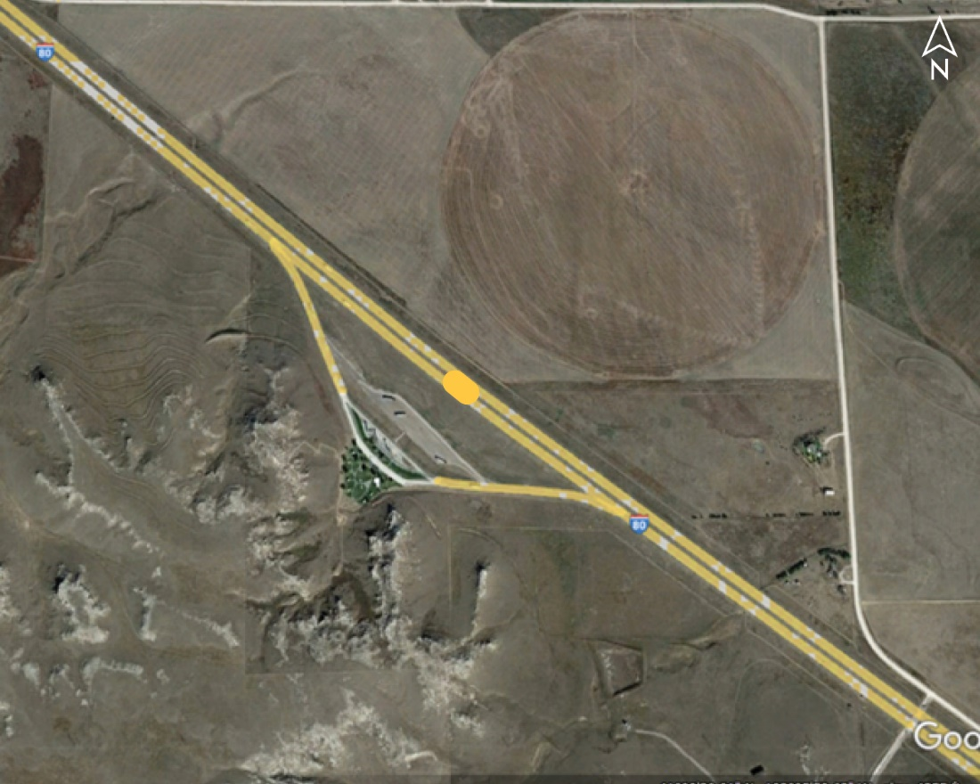
Sidney EB Rest Area Buildings (TK) (LET) Project No.: NH-80-1(169); Control No.: 51275A
Project Length: 0
Scope of Work:
Misc.
Grading

Slide 28
Sidney EB Rest Area Buildings (TK) (LET) Project No.: NH-80-1(169); Control No.: 51275A
Status: Award Pending
Right-of-Way: Not Required
Traffic Impacts:
Other
Letting Date: 7/13/2023
Construction Timing: 9/11/2023

Slide 29
Sidney EB Rest Area Buildings (TK) (LET) Project No.: NH-80-1(169); Control No.: 51275A
Anticipated Utilities Impact:
New Alignment
Grading
Culvert Extension/Replace
Anticipated Request from Utilities:
Coordination with NDOT
Locates
Additional Information:
No K-Sheets Required
No Special Provisions Required
Utilities Involved:
High West Energy, Lumen (CenturyLink)

Slide 30
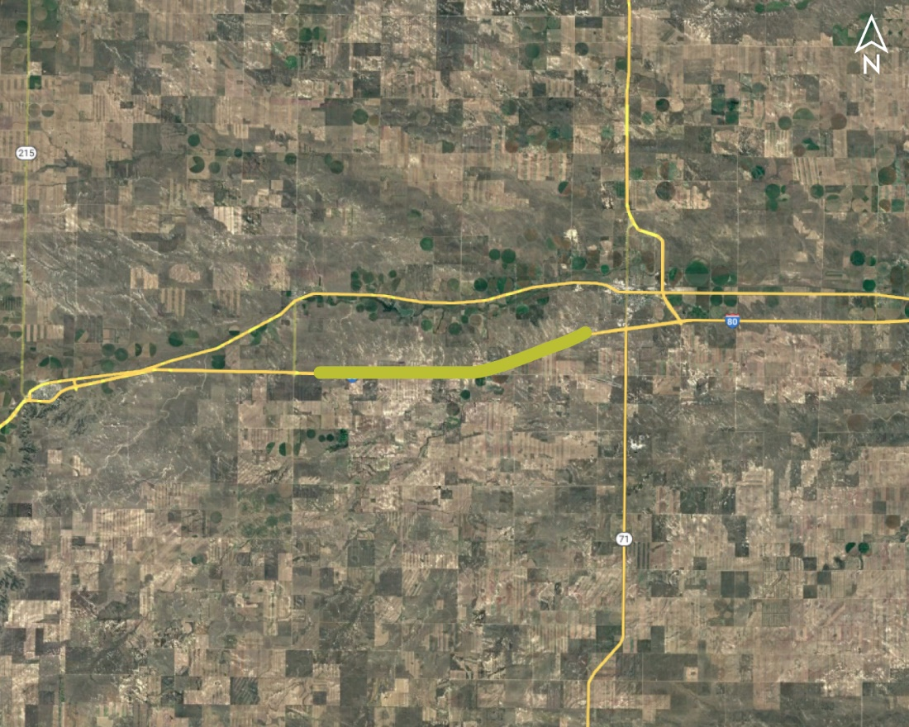
Bushnell - West Kimball Project No.: NH-80-1(196); Control No.: 51583
Project Length: 9.49
Scope of Work:
Full Depth Pavement
Culvert Extension/Replace
Guardrail

Slide 31
Bushnell - West Kimball Project No.: NH-80-1(196); Control No.: 51583
Status: Construction in Progress
Right-of-Way: Not Required
Traffic Impacts:
Phase Traffic Control
Letting Date: Let
Construction Timing: In Progress

Slide 32
Bushnell - West Kimball Project No.: NH-80-1(196); Control No.: 51583
Anticipated Utilities Impact:
Full Depth Pavement
Grading
Culvert Extension/Replace
Anticipated Request from Utilities:
Coordination with NDOT
Additional Information:
No K-Sheets Required
No Special Provisions Required
Utilities Involved:
Warren Air Force Base, Coaral Productions, Dalton Tele., Great Plains Comm., High West Energy, Tallgrass Energy, TRI Family Oil

Slide 33
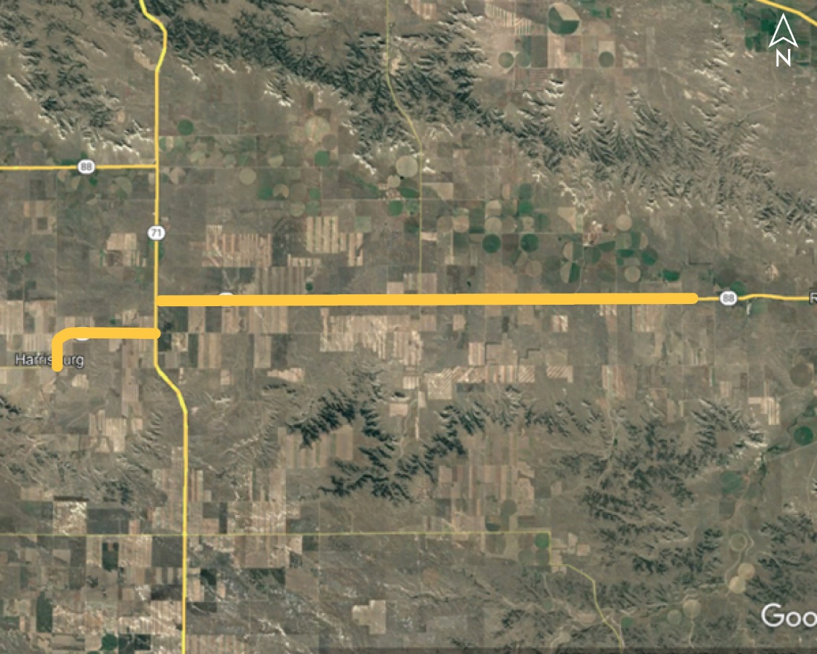
S. Jct. N-71 East Project No.: STP-88-1(110); Control No.: 51561
Project Length: 20.37
Scope of Work:
Resurfacing
Bridge Repair
Grading

Slide 34
S. Jct. N-71 East Project No.: STP-88-1(110); Control No.: 51561
Status: Construction in Progress
Right-of-Way: Completed
Traffic Impacts:
Phase Traffic Control
Letting Date: 6/15/2023
Construction Timing: 8/21/2023

Slide 35
S. Jct. N-71 East Project No.: STP-88-1(110); Control No.: 51561
Anticipated Utilities Impact:
Guardrail
Culvert Extension/Replace
Anticipated Request from Utilities:
Coordination with NDOT
Provide Existing Locations
Additional Information:
No K-Sheets Required
No Special Provisions Required
Utilities Involved:
Lumen, North Platte NRD,Great Plains Comm., Warren Air Force Base, Viaero Fiber, OPTK Network, CHACO Energy, Enbridge, Wyrulec Co., T-Mobile/ Sprint

Slide 36
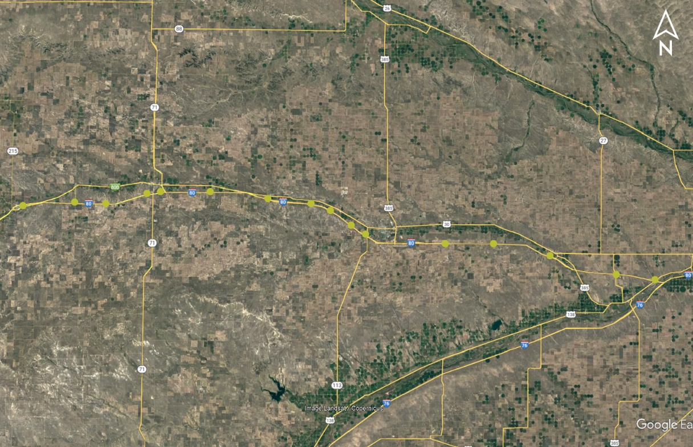
D5 VSA Project No.: ITS-MISC-D5(1010); Control No.: 51599
Project Length: 0
Scope of Work:
ITS/Lighting
Grading

Slide 37
D5 VSA Project No.: ITS-MISC-D5(1010); Control No.: 51599
Status: Construction in Progress
Right-of-Way: Completed
Traffic Impacts:
Phase Traffic Control
Letting Date: Let
Construction Timing: In Progress

Slide 38
D5 VSA Project No.: ITS-MISC-D5(1010); Control No.: 51599
Anticipated Utilities Impact:
Shlder Work
Anticipated Request from Utilities:
Coordination with NDOT
Additional Information:
No K-Sheets Required
No Special Provisions Required
Utilities Involved:
AT&T, Black Hills Energy, Lumen/Century Link, Charter Comm., City of Chappell, City of Kimball, City of Sidney, Dalton Tele., Foundation Energy, Great Plains Comm., High West Energy, Highline Electric, Kinder Morgan, Nebraska Rural Electric, Nebraska PPD, Cogent Comm-T-Mobile/Sprint, Tallgrass, Viaero, Western Area Power Admn, Wheatbelt PPD

Slide 39
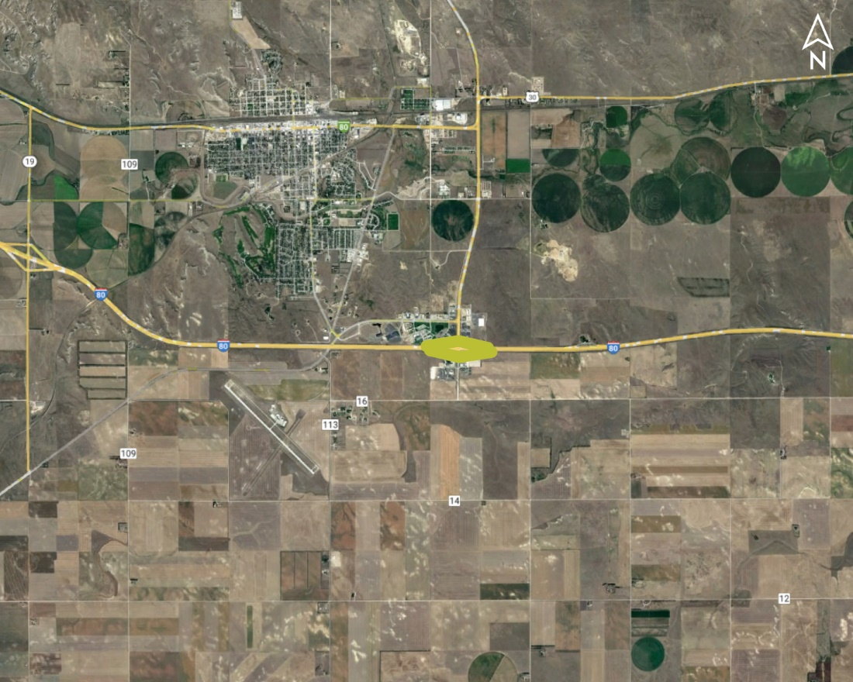
Sidney Interchange Lighting Project No.: NH-80-2(116); Control No.: 51619
Project Length: 0
Scope of Work:
ITS/Lighting
Grading

Slide 40
Sidney Interchange Lighting Project No.: NH-80-2(116); Control No.: 51619
Status: Construction in Progress
Right-of-Way: Not Required
Traffic Impacts:
Phase Traffic Control
Letting Date: Let
Construction Timing: 10/2/2023

Slide 41
Sidney Interchange Lighting Project No.: NH-80-2(116); Control No.: 51619
Anticipated Utilities Impact:
Lighting
Shlder Work
Anticipated Request from Utilities:
Coordination with NDOT
Additional Information:
No K-Sheets Required
Special Provisions Required
Utilities Involved:
City of Sidney, Gas Present, and Telephone Present, USAF Cable present

Slide 42
Construction Year 2024
The following projects are anticipated to be let during 2024
Notes:
Kathy Fischer or Rhett Robinson

Slide 43
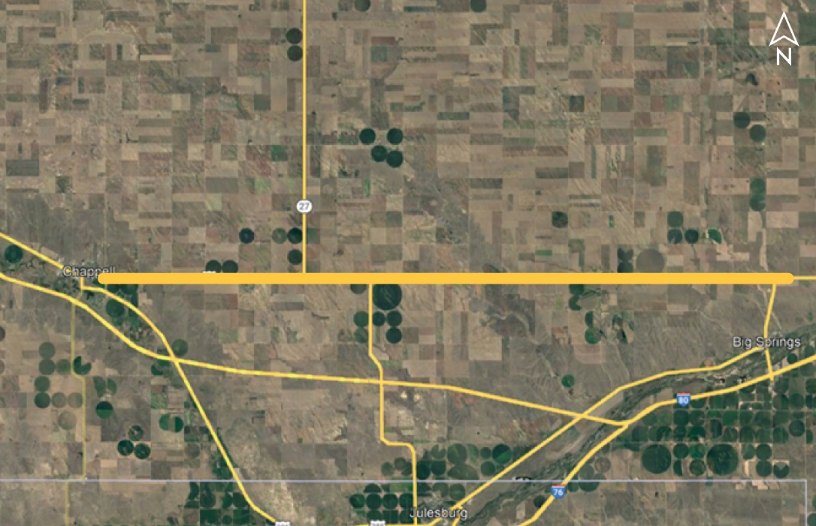
Chappell East (MS) Project No.: STP-30-1(139); Control No.: 51462A
Project Length: 10.11
Scope of Work:
Resurfacing
Full Depth Pavement
Culvert Extension/Replace

Slide 44
Chappell East (MS) Project No.: STP-30-1(139); Control No.: 51462A
Status: Preparing for Bid
Right-of-Way: Completed
Traffic Impacts:
Phase Traffic Control
Full Detour
Letting Date: 11/16/2023
Construction Timing: 6/1/2024

Slide 45
Chappell East (MS) Project No.: STP-30-1(139); Control No.: 51462A
Anticipated Utilities Impact:
New ROW
Culvert Extension/Replacement
Bridge Repair/Replacement
Anticipated Request from Utilities:
Provide Existing Locations
Coordination with NDOT
Locates
Additional Information:
K-Sheets Required
Special Provisions Required
Utilities Involved:
AT&T Comm., Black Hills Energy, City of Chappell, Highline Electric, Lumen (CenturyLink), Nebraska PPD, OPTK Networks (NebraskaLink), Wheatbelt PPD

Slide 46
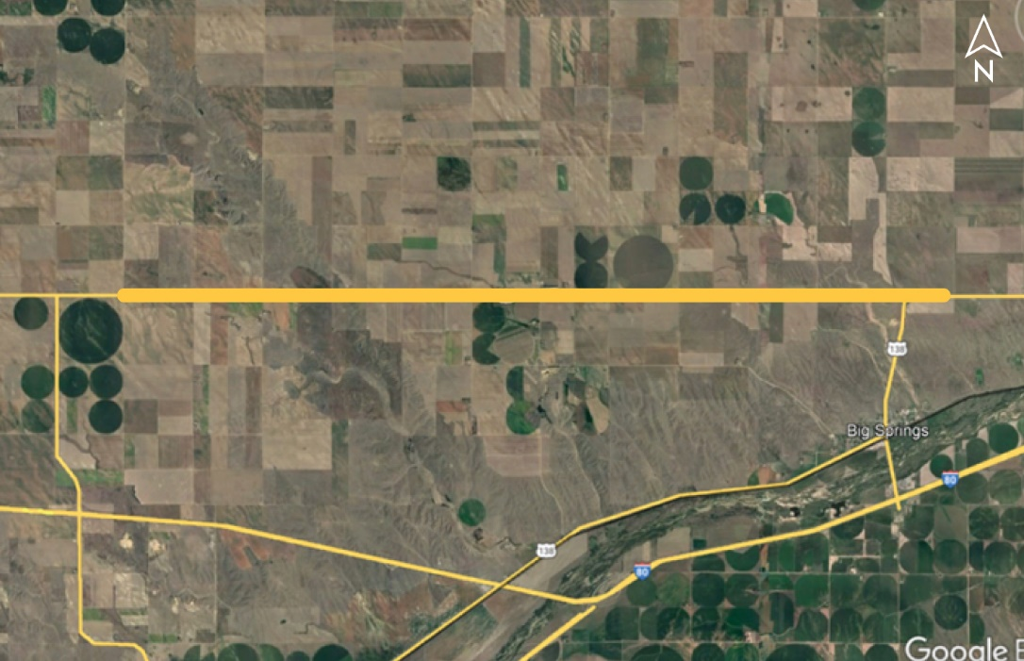
US-138 West (MS) Project No.: STP-30-1(140); Control No.: 51463A
Project Length: 10.38
Scope of Work:
Resurfacing
Full Depth Pavement
Culvert Extension/Replace

Slide 47
US-138 West (MS) Project No.: STP-30-1(140); Control No.: 51463A
Status: Preparing for Bid
Right-of-Way: Completed
Traffic Impacts:
Phase Traffic Control
Full Detour
Letting Date: 11/16/2023
Construction Timing: 6/1/2024

Slide 48
US-138 West (MS) Project No.: STP-30-1(140); Control No.: 51463A
Anticipated Utilities Impact:
New ROW
Culvert Extension/Replacement
Bridge Repair/Replacement
Anticipated Request from Utilities:
Provide Existing Locations
Coordination with NDOT
Locates
Additional Information:
K-Sheets Required
Special Provisions Required
Utilities Involved:
Black Hills Energy, Kinder Morgan, Lumen (CenturyLink), Nebraska PPD, Tallgrass Energy, Wheatbelt PPD, KEBRH

Slide 49
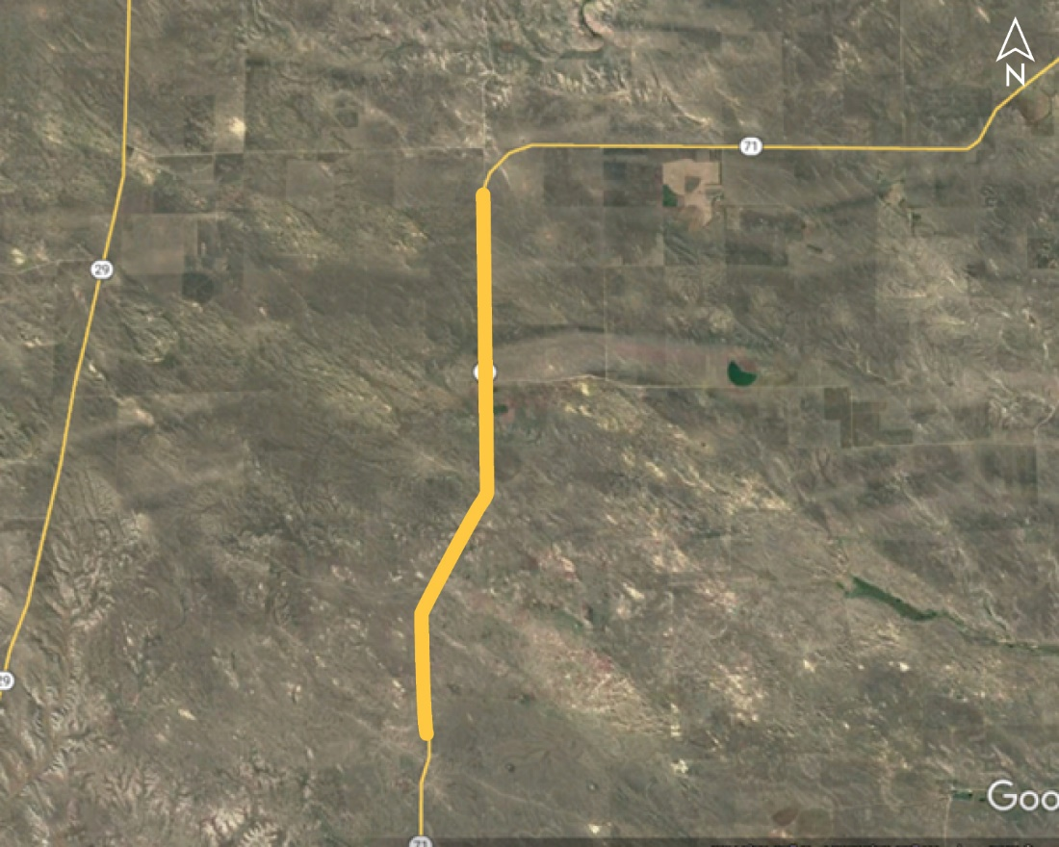
Watson Ranch South (MS) Project No.: STP-71-4(116); Control No.: 51018
Project Length: 9.13
Scope of Work:
Resurfacing
Culvert Extension/Replace
Misc.

Slide 50
Watson Ranch South (MS) Project No.: STP-71-4(116); Control No.: 51018
Status: Preparing for Bid
Right-of-Way: Not Required
Traffic Impacts:
Phase Traffic Control
Letting Date: 2/1/2024
Construction Timing: 6/1/2024

Slide 51
Watson Ranch South (MS) Project No.: STP-71-4(116); Control No.: 51018
Anticipated Utilities Impact:
Culvert Extension/Replacement
Grading
Anticipated Request from Utilities:
Provide Existing Locations
Coordination with NDOT
Additional Information:
No K-Sheets Required
No Special Provisions Required
Utilities Involved:
Great Plains Comm., Lumen (CenturyLink), Nebraska PPD, OPTK Networks (NebraskaLink), Panhandle Rural Electric

Slide 52
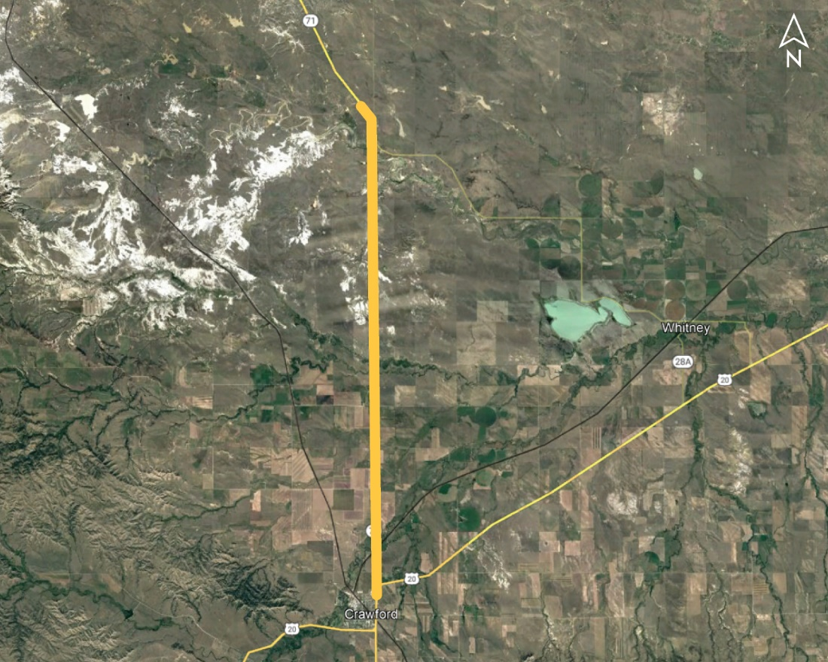
Crawford North Project No.: STP-71-4(118); Control No.: 51185
Project Length: 11.69
Scope of Work:
Resurfacing
Bridge Repair
Guardrail

Slide 53
Crawford North Project No.: STP-71-4(118); Control No.: 51185
Status: Preparing for Bid
Right-of-Way: Not Required
Traffic Impacts:
Phase Traffic Control
Letting Date: 2/29/2024
Construction Timing: 6/17/2024

Slide 54
Crawford North Project No.: STP-71-4(118); Control No.: 51185
Anticipated Utilities Impact:
Bridge Repair/Replacement
Guardrail
Culvert Extension/Replacement
Anticipated Request from Utilities:
Provide Existing Locations
Coordination with NDOT
Additional Information:
No K-Sheets Required
No Special Provisions Required
Utilities Involved:
Black Hills Energy, City of Crawford , Hemingford Coop Telephone Co., Lumen (CenturyLink), Mobius Comm. Co., Nebraska PPD, Northwest Rural PPD, OPTK Networks (NebraskaLink), Spring Creek Pipeline Co.

Slide 55
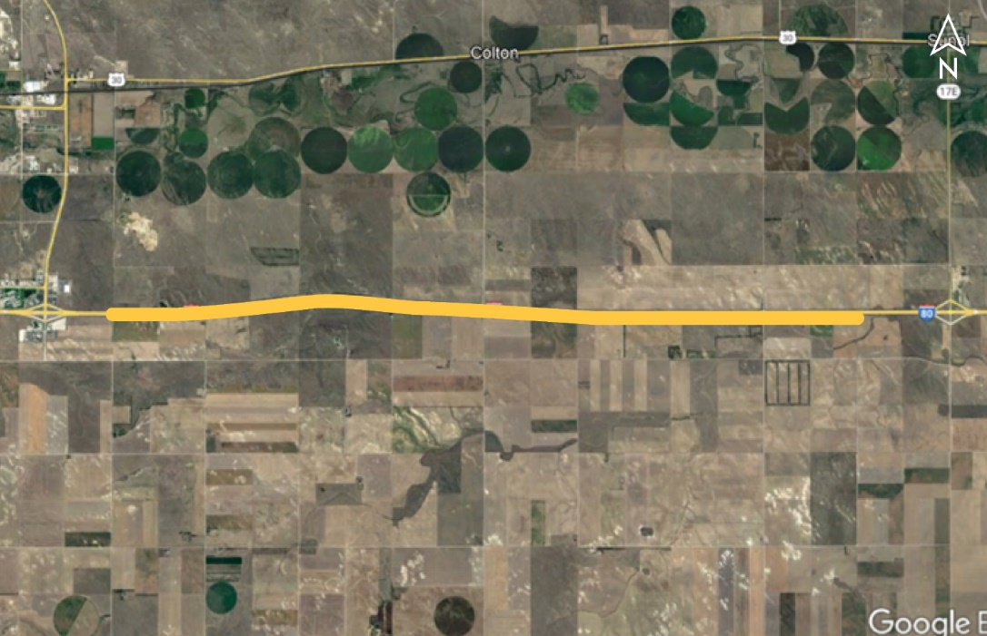
Sidney - Sunol Project No.: NH-80-2(109); Control No.: 51585
Project Length: 8
Scope of Work:
Resurfacing
Bridge Repair

Slide 56
Sidney - Sunol Project No.: NH-80-2(109); Control No.: 51585
Status: Preparing for Bid
Right-of-Way: Not Required
Traffic Impacts:
Phase Traffic Control
Letting Date: 2/29/2023
Construction Timing: 4/1/2024

Slide 57
Sidney - Sunol Project No.: NH-80-2(109); Control No.: 51585
Anticipated Utilities Impact:
Guardrail
Access Crossings
Overhead Power Line Crossing
Anticipated Request from Utilities:
Provide Existing Locations
Coordination with NDOT
Additional Information:
No K-Sheets Required
No Special Provisions Required
Utilities Involved:
Black Hills Energy, Charter Comm. (Spectrum), City of Sidney, High West Energy, Lumen (CenturyLink), Tallgrass Energy, USAF –Warren AFB 90th MMX/HICS, Wheatbelt PPD

Slide 58
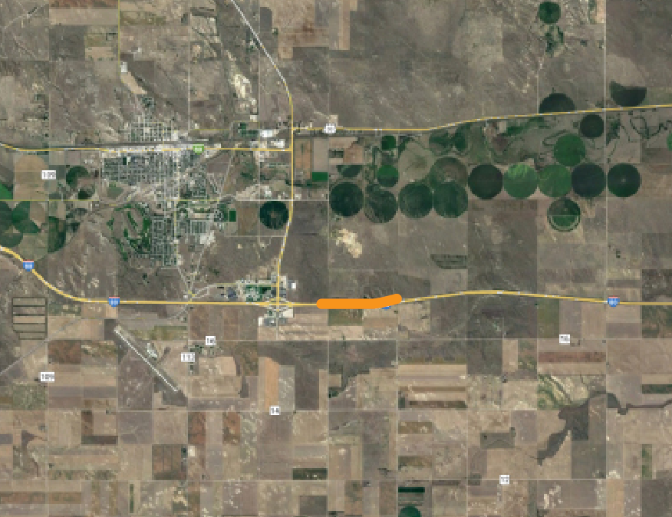
Sidney WB Rest Area Parking Lot & Ramps (MS) Project No.: NH-80-2(117); Control No.: 51625
Project Length: 0
Scope of Work:
Full Depth Pavement
Culvert Extension/Replace
Grading

Slide 59
Sidney WB Rest Area Parking Lot & Ramps (MS) Project No.: NH-80-2(117); Control No.: 51625
Status: Preparing for Bid
Right-of-Way: Completed
Traffic Impacts:
Other
Letting Date: 2/29/2024
Construction Timing: 7/8/2024

Slide 60
Sidney WB Rest Area Parking Lot & Ramps (MS) Project No.: NH-80-2(117); Control No.: 51625
Anticipated Utilities Impact:
New Alignment
Grading
Lighting
Anticipated Request from Utilities:
Provide Existing Locations
Coordination with NDOT
Locates
Additional Information:
K-Sheets TBD
Special Provisions TBD
Utilities Involved:
Lumen (CenturyLink), USAF –Warren AFB 90th MMX/HICS, Wheatbelt PPD

Slide 61
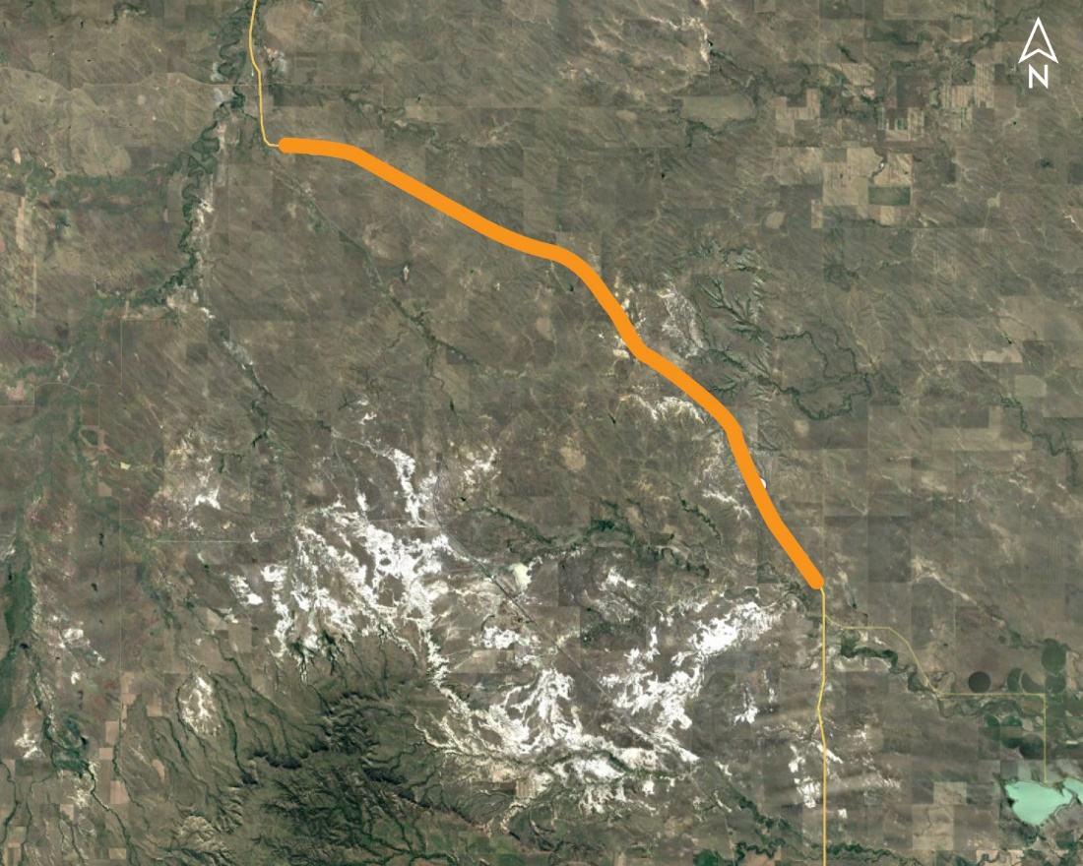
South Dakota Line South Project No.: STP-71-4(126); Control No.: 51645
Project Length: 16.86
Scope of Work:
Resurfacing

Slide 62
South Dakota Line South Project No.: STP-71-4(126); Control No.: 51645
Status: Preparing for Bid
Right-of-Way: Not Required
Traffic Impacts:
Phase Traffic Control
Letting Date: 2/1/2024
Construction Timing: 7/22/2024

Slide 63
South Dakota Line South Project No.: STP-71-4(126); Control No.: 51645
Anticipated Utilities Impact:
Shoulder Work
Anticipated Request from Utilities:
Provide Existing Locations
Coordination with NDOT
Additional Information:
No K-Sheets Required
No Special Provisions Required
Utilities Involved:
Golden West Telephone Co., Lumen (Century Link), Mobius Comm. Co., Spring Creek Pipeline Co.

Slide 64
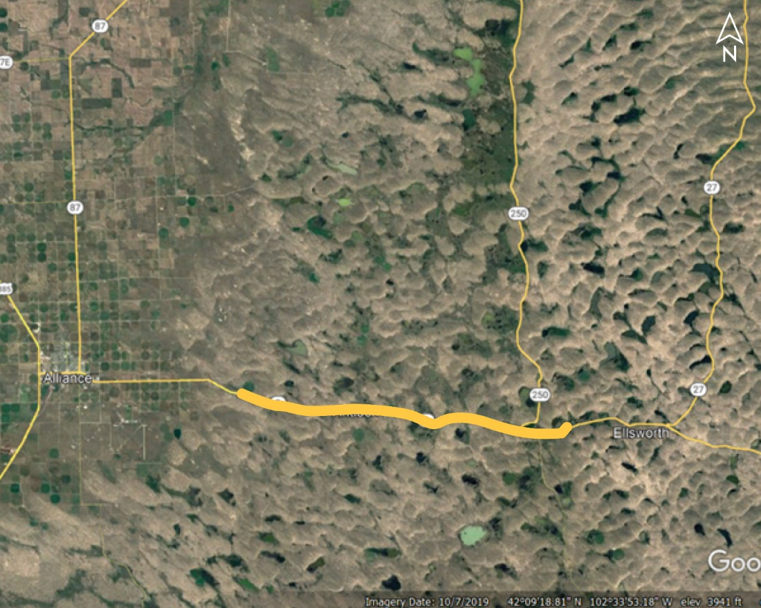
Box Butte/Sheridan Co. Line East Project No.: NH-2-1(127); Control No.: 51614
Project Length: 16.91
Scope of Work:
Resurfacing
Shoulder Work

Slide 65
Box Butte/Sheridan Co. Line East Project No.: NH-2-1(127); Control No.: 51614
Status: Design
Right-of-Way: Not Required
Traffic Impacts:
Phase Traffic Control
Letting Date: 2/1/2024
Construction Timing: 5/1/2024

Slide 66
Box Butte/Sheridan Co. Line East Project No.: NH-2-1(127); Control No.: 51614
Anticipated Utilities Impact:
Culvert Extension/Replacement
Shoulder Work
Anticipated Request from Utilities:
Provide Existing Locations
Coordination with NDOT
Additional Information:
No K-Sheets Required
No Special Provisions Required
Utilities Involved:
AT&T Comm., Black Hills Energy, Charter Comm. (Spectrum), City of Gordon, Great Plains Comm., Lumen (CenturyLink), Nebraska PPD, Panhandle Rural Electric, Rural Nebraska Healthcare Network, Viaero Fiber Net. (NE-CO Cell.)

Slide 67
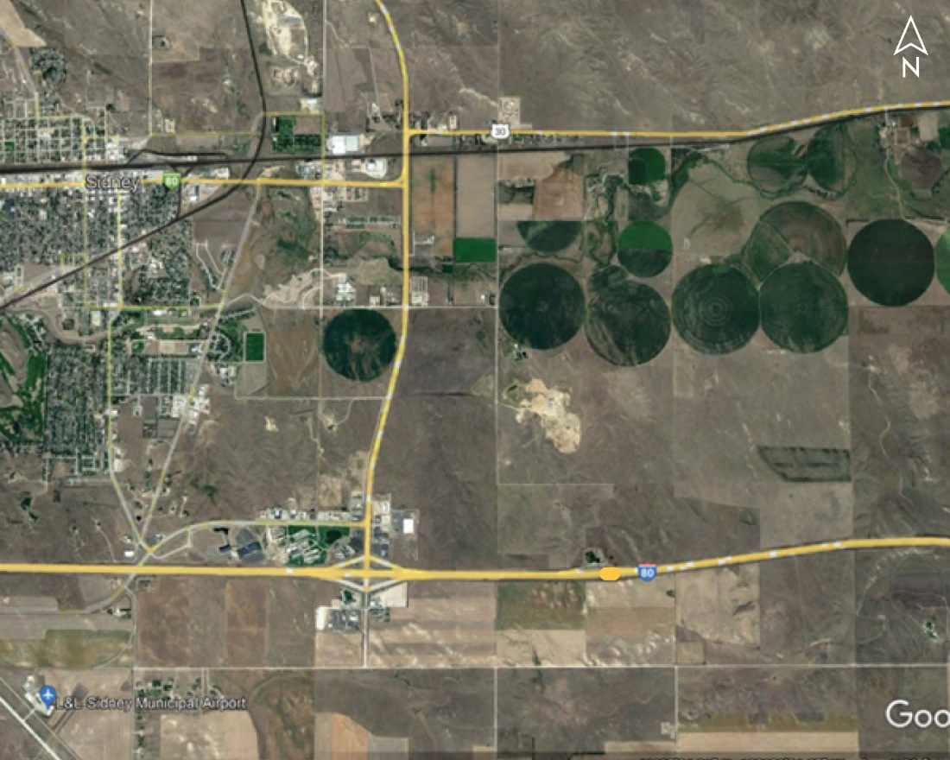
Sidney WB Rest Area Building Project No.: NH-80-2(92); Control No.: 51276A
Project Length: 0
Scope of Work:
Misc.
Grading

Slide 68
Sidney WB Rest Area Building Project No.: NH-80-2(92); Control No.: 51276A
Status: Preparing for Bid
Right-of-Way: Not Required
Traffic Impacts:
Other
Letting Date: 7/25/2024
Construction Timing: 10/1/2024

Slide 69
Sidney WB Rest Area Building Project No.: NH-80-2(92); Control No.: 51276A
Anticipated Utilities Impact:
Grading
Anticipated Request from Utilities:
Provide Existing Locations
Coordination with NDOT
Additional Information:
No K-Sheets Required
No Special Provisions Required
Utilities Involved:
Lumen (CenturyLink), USAF –Warren AFB 90th MMX/HICS, Wheatbelt PPD

Slide 70
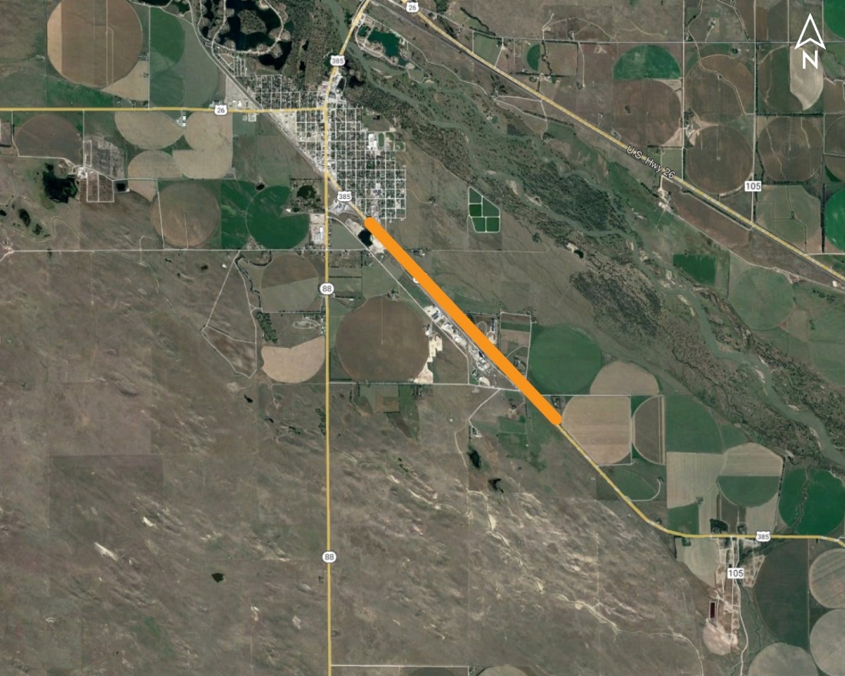
US-385 South of Bridgeport Project No.: MISC-385-3(1025); Control No.: 51665
Project Length: 0.75
Scope of Work:
Full Depth Pavement
Grading
Shoulder Work

Slide 71
US-385 South of Bridgeport Project No.: MISC-385-3(1025); Control No.: 51665
Status: Design
Right-of-Way: In Progress
Traffic Impacts:
Phase Traffic Control
Letting Date: 7/25/2024
Construction Timing: 9/9/2024

Slide 72
US-385 South of Bridgeport Project No.: MISC-385-3(1025); Control No.: 51665
Anticipated Utilities Impact:
New ROW
New Alignment
Full Depth Pavement
Anticipated Request from Utilities:
Provide Existing Locations
Coordination with NDOT
Locates
Additional Information:
K-Sheets Required
Special Provisions Required
Utilities Involved:
Black Hills Energy, Charter Comm. (Spectrum), City of Bridgeport, Lumen (CenturyLink), OPTK Networks (NebraskaLink), Tallgrass Energy, Wheatbelt PPD

Slide 73
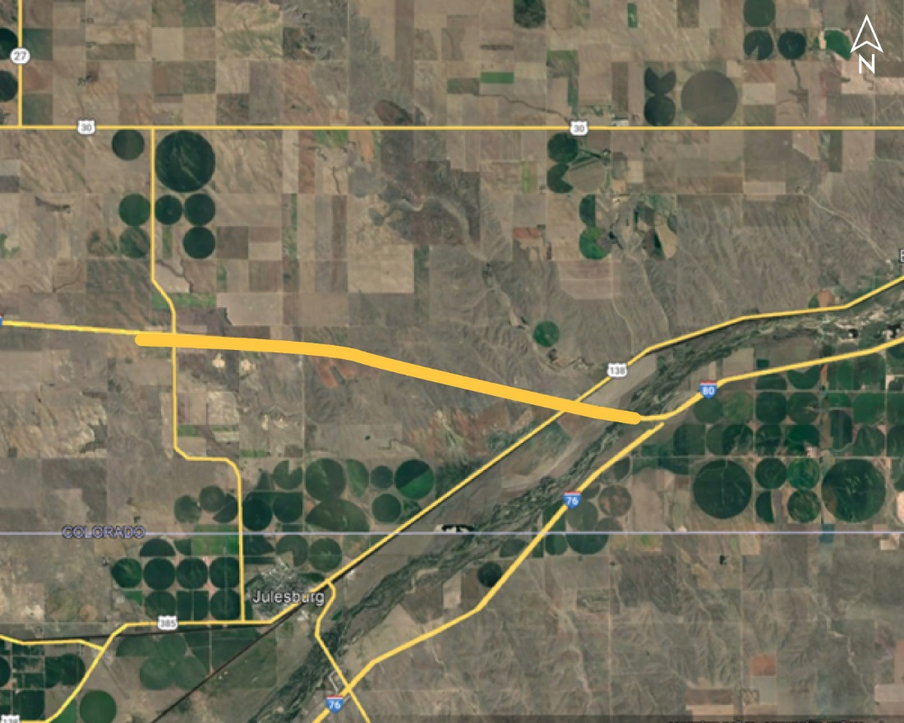
Oshkosh - I-76 Project No.: NH-80-2(112); Control No.: 51591
Project Length: 7.8
Scope of Work:
Pavement Repairs

Slide 74
Oshkosh - I-76 Project No.: NH-80-2(112); Control No.: 51591
Status: Award Pending
Right-of-Way: Not Required
Traffic Impacts:
Phase Traffic Control
Letting Date: 9/28/2023
Construction Timing: 8/1/2024

Slide 75
Oshkosh - I-76 Project No.: NH-80-2(112); Control No.: 51591
Anticipated Utilities Impact:
No Impacts
Anticipated Request from Utilities:
Provide Existing Locations
Coordination with NDOT
Additional Information:
No K-Sheets Required
No Special Provisions Required
Utilities Involved:
AT&T Comm., Black Hills Energy, Charter Comm. (Spectrum), Lumen (CenturyLink), Nebraska PPD, Cogent Comm. Inc (T-Mobile, Sprint), Verizon (MCI), Wheatbelt PPD

Slide 76
Construction YEAR 2025
The following projects are anticipated to be let during 2025
Notes:
Kathy Fischer or Rhett Robinson

Slide 77
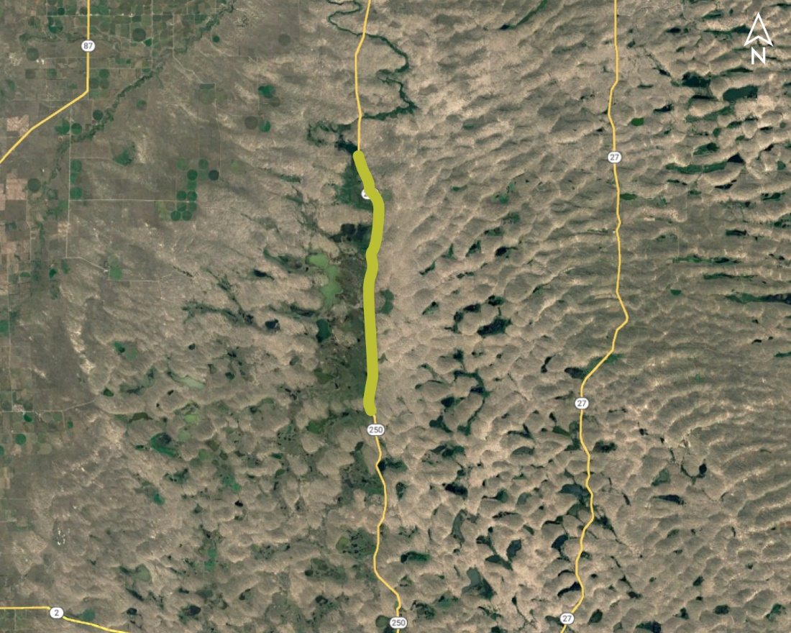
Smith Lake South (MS) Project No.: STP-250-4(103); Control No.: 51192
Project Length: 12.7
Scope of Work:
Resurfacing
Culvert Extension/Replace
Misc.

Slide 78
Smith Lake South (MS) Project No.: STP-250-4(103); Control No.: 51192
Status: Design
Right-of-Way: In Progress
Traffic Impacts:
Phase Traffic Control
Letting Date: 8/29/2024
Construction Timing: 4/21/2025

Slide 79
Smith Lake South (MS) Project No.: STP-250-4(103); Control No.: 51192
Anticipated Utilities Impact:
Shoulder Work
Grading
Anticipated Request from Utilities:
Provide Existing Locations
Coordination with NDOT
Additional Information:
No K-Sheets Required
No Special Provisions Required
Utilities Involved:
City of Rushville-Sewer, Great Plains Comm., Lumen (Century Link), Panhandle Rural Electric

Slide 80
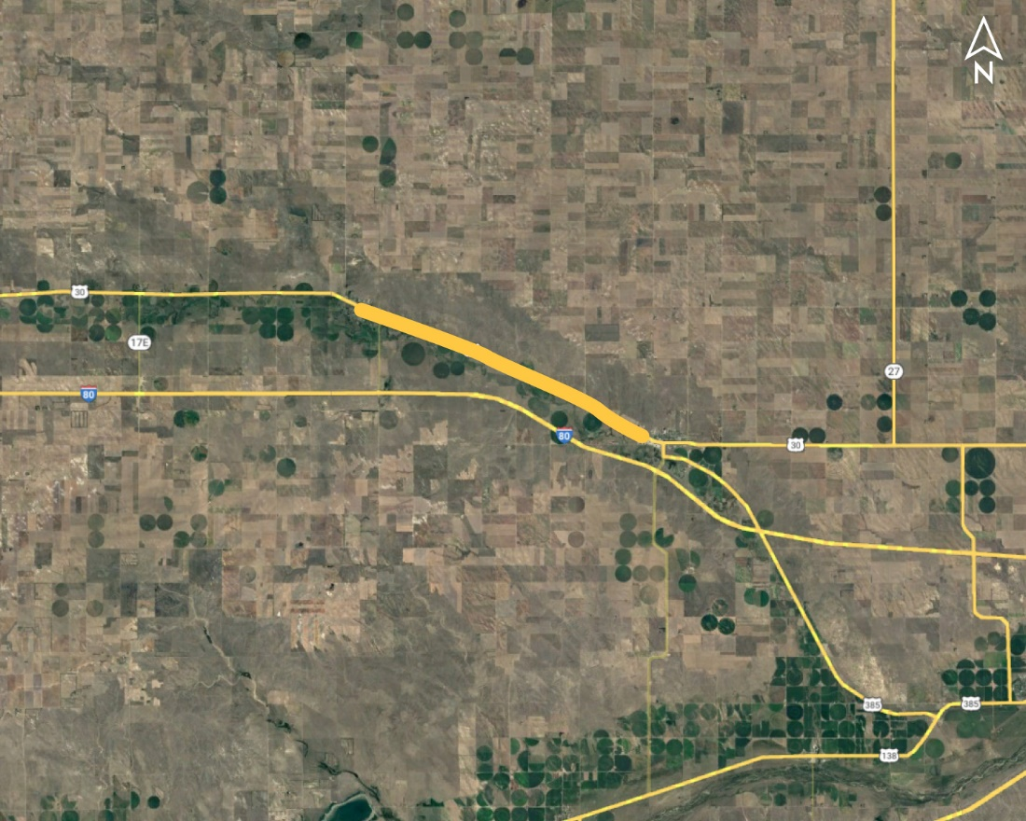
Lodgepole - Chappell (MS) Project No.: STP-30-1(129); Control No.: 51401
Project Length: 8.18
Scope of Work:
Resurfacing
Culvert Extension/Replace

Slide 81
Lodgepole - Chappell (MS) Project No.: STP-30-1(129); Control No.: 51401
Status: Design
Right-of-Way: In Progress
Traffic Impacts:
Phase Traffic Control
Letting Date: 8/29/2024
Construction Timing: 7/22/2025

Slide 82
Lodgepole - Chappell (MS) Project No.: STP-30-1(129); Control No.: 51401
Anticipated Utilities Impact:
Culvert Extension/Replacement
New ROW
Access Crossings
Anticipated Request from Utilities:
Provide Existing Locations
Coordination with NDOT
Additional Information:
No K-Sheets Required
No Special Provisions Required
Utilities Involved:
Black Hills Energy, Charter Comm. (Spectrum), City of Chappell, Dalton Telephone Co., Lumen (CenturyLink), OPTK Networks (NebraskaLink), Cogent Comm. Inc (T-Mobile, Sprint), Village of Lodgepole, Wheatbelt PPD

Slide 83
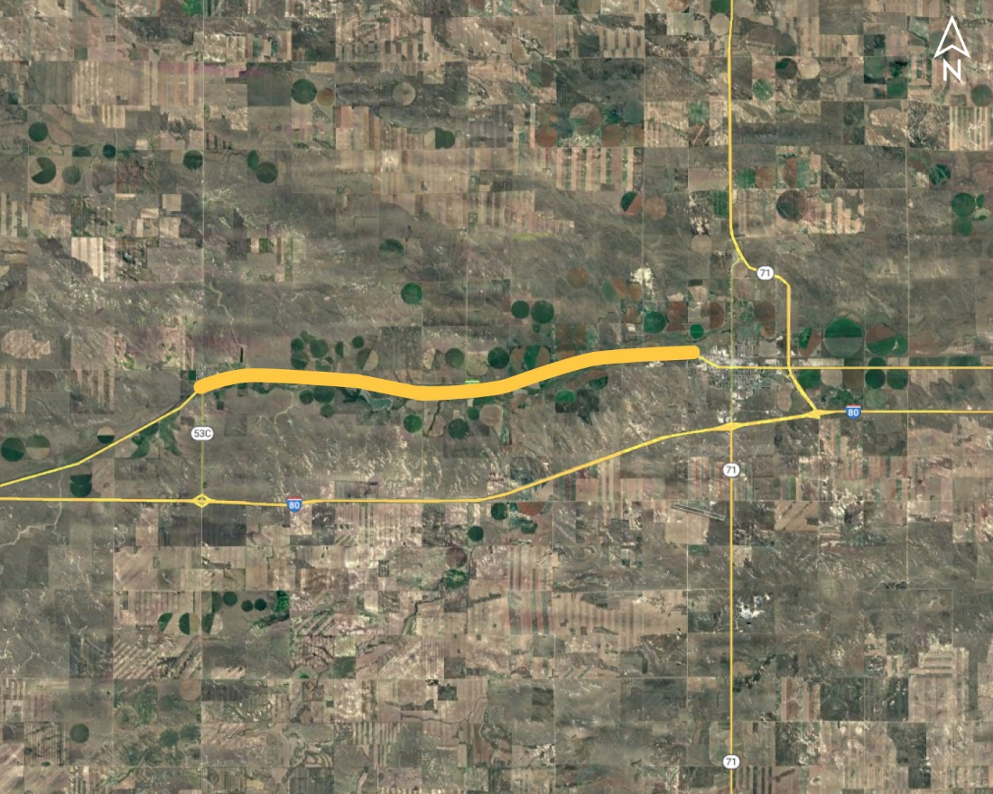
Bushnell - Kimball Project No.: STP-30-1(138); Control No.: 51560
Project Length: 11.43
Scope of Work:
Resurfacing
Grading
Guardrail

Slide 84
Bushnell - Kimball Project No.: STP-30-1(138); Control No.: 51560
Status: Design
Right-of-Way: In Progress
Traffic Impacts:
Phase Traffic Control
Letting Date: 8/29/2024
Construction Timing: 6/9/2025

Slide 85
Bushnell - Kimball Project No.: STP-30-1(138); Control No.: 51560
Anticipated Utilities Impact:
Bridge Repair/Replacement
Shoulder Work
Anticipated Request from Utilities:
Provide Existing Locations
Coordination with NDOT
Additional Information:
No K-Sheets Required
No Special Provisions Required
Utilities Involved:
Black Hills Energy, Village of Bushnell, Charter Comm. (Spectrum), Dalton Telephone Co., High West Energy, Kimball Wind LLC, City of Kimball, Lumen (CenturyLink), Rural Nebraska Healthcare Network, Cogent Comm. Inc (T-Mobile, Sprint), Tallgrass Energy

Slide 86
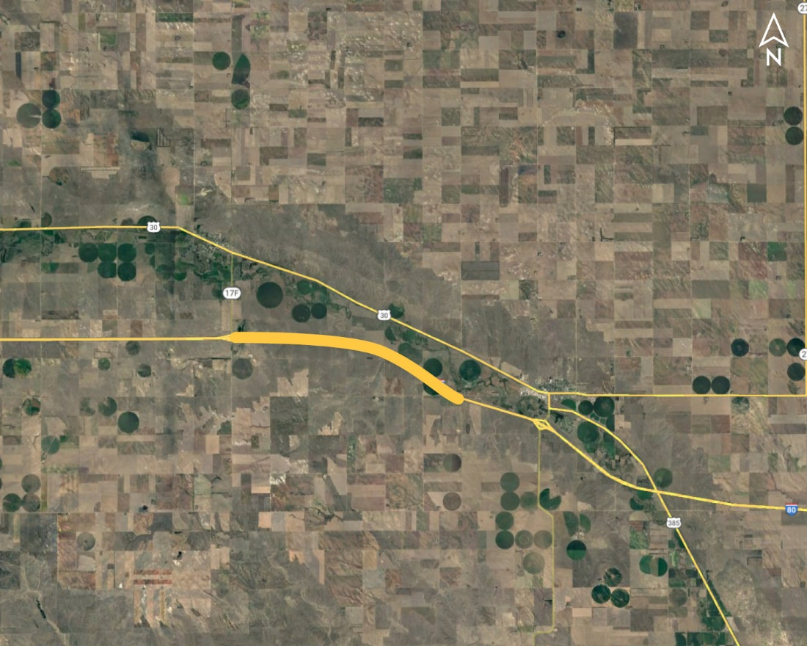
Lodgepole Area Bridges Project No.: NH-80-2(115); Control No.: 51617
Project Length: 0
Scope of Work:
Bridge Repair

Slide 87
Lodgepole Area Bridges Project No.: NH-80-2(115); Control No.: 51617
Status: Design
Right-of-Way: Not Required
Traffic Impacts:
Phase Traffic Control
Letting Date: 8/29/2024
Construction Timing: 5/1/2025

Slide 88
Lodgepole Area Bridges Project No.: NH-80-2(115); Control No.: 51617
Anticipated Utilities Impact:
Bridge Repair/Replacement
Anticipated Request from Utilities:
Provide Existing Locations
Coordination with NDOT
Additional Information:
No K-Sheets Required
No Special Provisions Required
Utilities Involved:
Black Hills Energy, Dalton Telephone Co., Lumen (CenturyLink), Wheatbelt PPD

Slide 89
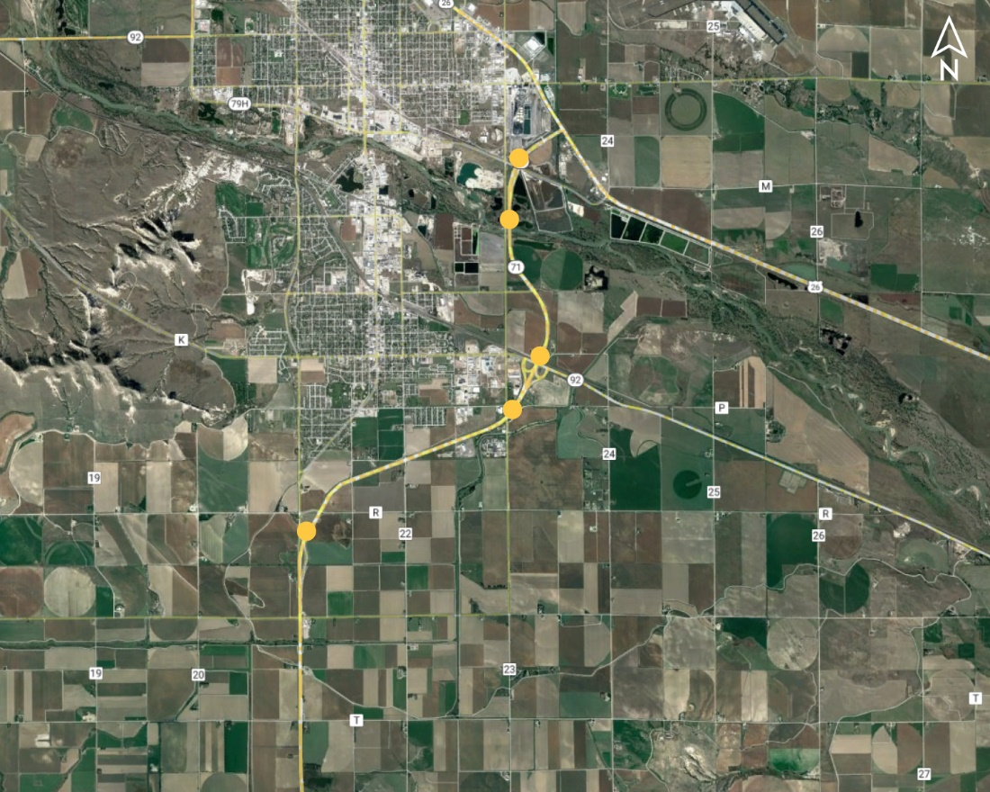
Scottsbluff Area Bridges Project No.: NH-71-3(128); Control No.: 51618
Project Length: 0
Scope of Work:
Bridge Repair

Slide 90
Scottsbluff Area Bridges Project No.: NH-71-3(128); Control No.: 51618
Status: Design
Right-of-Way: Not Required
Traffic Impacts:
Phase Traffic Control
Letting Date: 8/29/2024
Construction Timing: 5/1/2025

Slide 91
Scottsbluff Area Bridges Project No.: NH-71-3(128); Control No.: 51618
Anticipated Utilities Impact:
Bridge Repair/Replacement
Anticipated Request from Utilities:
Provide Existing Locations
Coordination with NDOT
Additional Information:
No K-Sheets Required
No Special Provisions Required
Utilities Involved:
Allo Comm., AT&T Comm., Black Hills Energy, Charter Comm. (Spectrum), City of Gering, City of Scottsbluff, Cityof Terrytown, Gering Irrigation Dist., Kinder Morgan, Lumen (CenturyLink), Nebraska PPD, OPTK Networks (NebraskaLink), Cogent Comm. Inc (T-Mobile, Sprint), Viaero Fiber Net. (NE-CO Cell.), WAPA

Slide 92
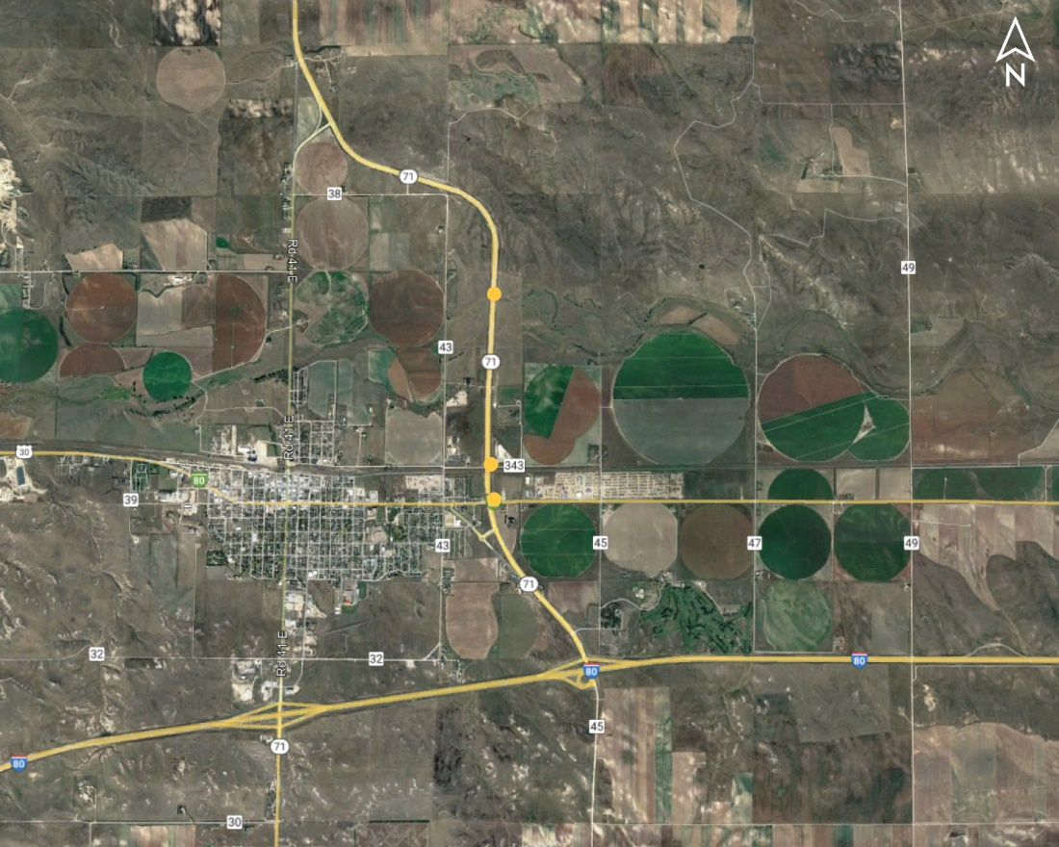
Kimball Area Bridges Project No.: NH-71-2(114); Control No.: 51620
Project Length: 0
Scope of Work:
Bridge Repair

Slide 93
Kimball Area Bridges Project No.: NH-71-2(114); Control No.: 51620
Status: Design
Right-of-Way: Not Required
Traffic Impacts:
Phase Traffic Control
Letting Date: 8/29/2024
Construction Timing: 5/1/2025

Slide 94
Kimball Area Bridges Project No.: NH-71-2(114); Control No.: 51620
Anticipated Utilities Impact:
Bridge Repair/Replacement
Anticipated Request from Utilities:
Provide Existing Locations
Coordination with NDOT
Additional Information:
No K-Sheets Required
No Special Provisions Required
Utilities Involved:
Black Hills Energy, Charter Comm. (Spectrum), City of Kimball, Dalton Telephone Co., Great Plains Comm., Lumen (CenturyLink), OPTK Networks (NebraskaLink), Cogent Comm. Inc (T-Mobile, Sprint), Viaero Fiber Net. (NE-CO Cell.)

Slide 95
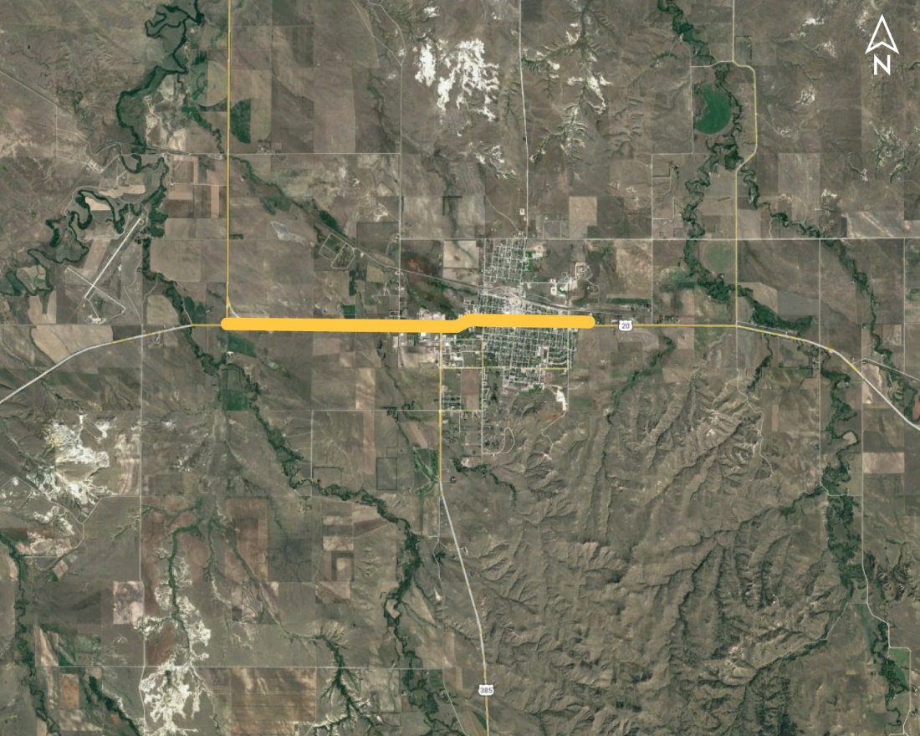
W Jct US-385 - Chadron (MS) Project No.: NH-20-1(150); Control No.: 51616
Project Length: 3.11
Scope of Work:
Resurfacing
Full Depth Pavement
Culvert Extension/Replace

Slide 96
W Jct US-385 - Chadron (MS) Project No.: NH-20-1(150); Control No.: 51616
Status: Design
Right-of-Way: In Progress
Traffic Impacts:
Phase Traffic Control
Letting Date: 11/7/2024
Construction Timing: 7/1/2025

Slide 97
W Jct US-385 - Chadron (MS) Project No.: NH-20-1(150); Control No.: 51616
Anticipated Utilities Impact:
Culvert Extension/Replacement
New ROW
Lighting
Anticipated Request from Utilities:
Provide Existing Locations
Coordination with NDOT
Additional Information:
No K-Sheets Required
Special Provisions TBD
Utilities Involved:
Black Hills Energy, Charter Comm., City of Chadron, Dawes County 911, Great Plains Comm. , Lumen (CenturyLink), Mobius Comm., Nebraska PPD, OPTK Networks (NebraskaLink), Rural Nebraska Healthcare

Slide 98
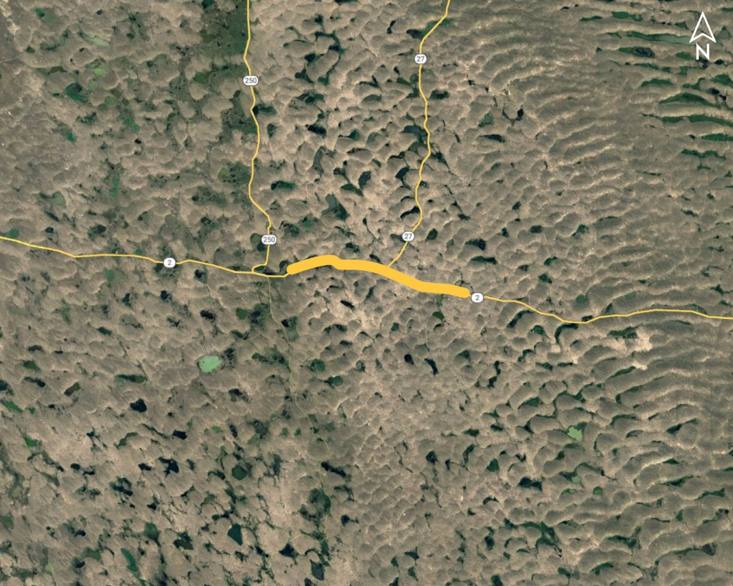
Lakeside East (MS) Project No.: NH-2-1(128); Control No.: 51646
Project Length: 10.55
Scope of Work:
Resurfacing
Pavement Repairs
Shoulder Work

Slide 99
Lakeside East (MS) Project No.: NH-2-1(128); Control No.: 51646
Status: Design
Right-of-Way: Not Required
Traffic Impacts:
Phase Traffic Control
Letting Date: 3/6/2025
Construction Timing: 5/1/2025

Slide 100
Lakeside East (MS) Project No.: NH-2-1(128); Control No.: 51646
Anticipated Utilities Impact:
Lighting
Anticipated Request from Utilities:
Provide Existing Locations
Coordination with NDOT
Additional Information:
K-Sheets TBD
Special Provisions TBD
Utilities Involved:
Allo Comm., Concolidated Telco, Lumen (CenturyLink), OPTK Network (NebraskaLink), Panhandle Rural Electic Membership Assn.

Slide 101
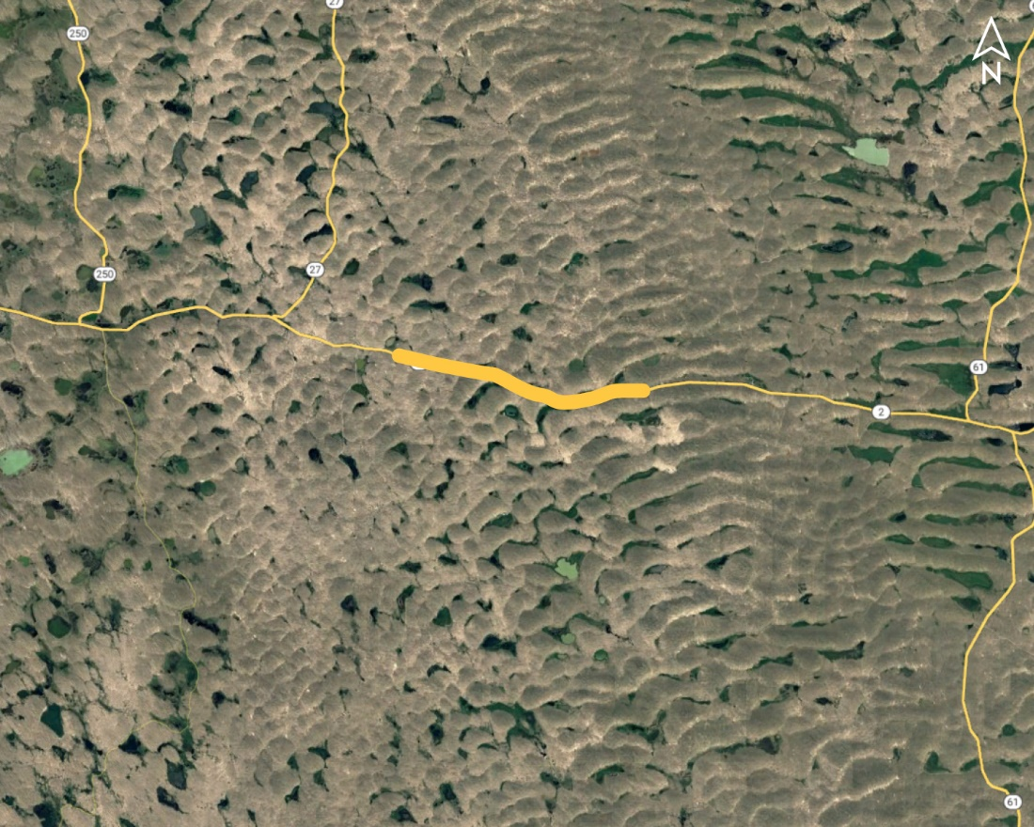
Burton Lake East (MS) Project No.: NH-2-1(129); Control No.: 51647
Project Length: 9.7
Scope of Work:
Resurfacing
Pavement Repairs
Shoulder Work

Slide 102
Burton Lake East (MS) Project No.: NH-2-1(129); Control No.: 51647
Status: Design
Right-of-Way: Not Required
Traffic Impacts:
Phase Traffic Control
Letting Date: 3/6/2025
Construction Timing: 5/1/2025

Slide 103
Burton Lake East (MS) Project No.: NH-2-1(129); Control No.: 51647
Anticipated Utilities Impact:
Culvert Extension/Replacement
Shoulder Work
Anticipated Request from Utilities:
Provide Existing Locations
Coordination with NDOT
Additional Information:
No K-Sheets Required
No Special Provisions Required
Utilities Involved:
Allo Comm., Concolidated Telco, Lumen (CenturyLink), OPTK Network (NebraskaLink), Panhandle Rural Electic Membership Assn.

Slide 104
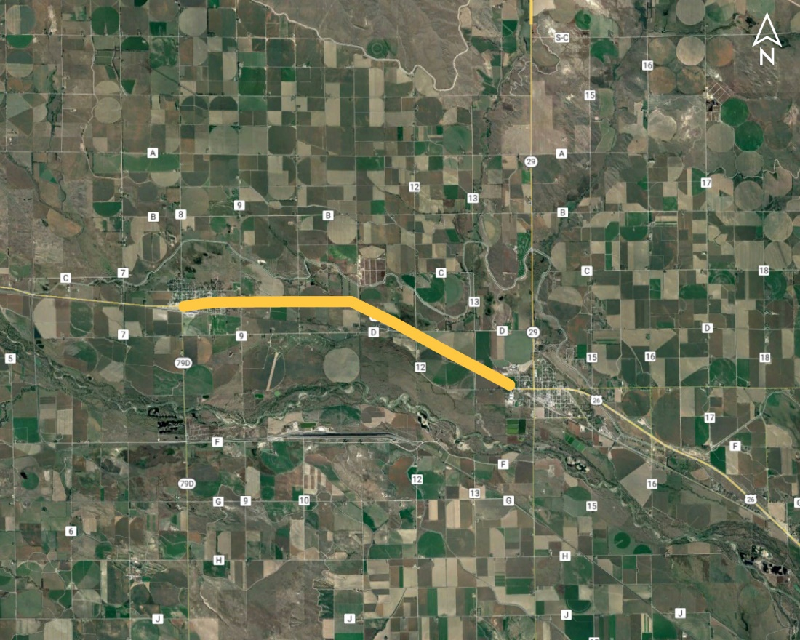
Morrill - Mitchell (MS) Project No.: NH-26-1(174); Control No.: 51615
Project Length: 6
Scope of Work:
Resurfacing
Pavement Repairs
ITS/Lighting

Slide 105
Morrill - Mitchell (MS) Project No.: NH-26-1(174); Control No.: 51615
Status: Design
Right-of-Way: In Progress
Traffic Impacts:
Phase Traffic Control
Letting Date: 8/29/2024
Construction Timing: 7/7/2025

Slide 107
Morrill - Mitchell (MS) Project No.: NH-26-1(174); Control No.: 51615
Anticipated Utilities Impact:
No Impacts
Shlder Work
Anticipated Request from Utilities:
Provide Existing Locations
Coordination with NDOT
Additional Information:
No K-Sheets Required
No Special Provisions Required
Utilities Involved:
Allo Comm., Black Hills Energy, Charter Comm. (Spectrum), City of Mitchell, Enterprise Irr. Dist., Farmers Irr. Dist., Great Plains Comm., Lumen (CenturyLink), Roosevelt PPD, Tallgrass Energy, Village of Morrill, Western Sugar COOP

Slide 108
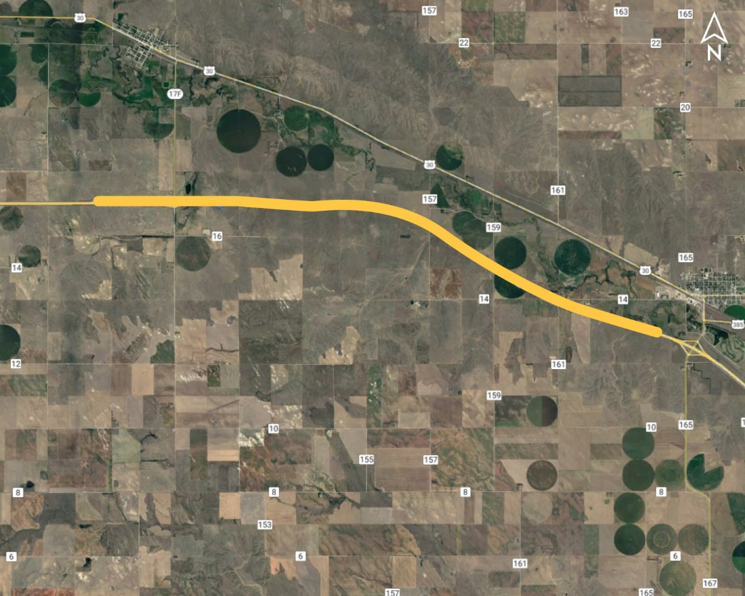
West of Lodgepole - West of Chappell Project No.: NH-80-2(118); Control No.: 51627
Project Length: 9.2
Scope of Work:
Pavement Repairs

Slide 109
West of Lodgepole - West of Chappell Project No.: NH-80-2(118); Control No.: 51627
Status: Design
Right-of-Way: Not Required
Traffic Impacts:
Phase Traffic Control
Letting Date: 8/29/2024
Construction Timing: 5/1/2025

Slide 110
West of Lodgepole - West of Chappell Project No.: NH-80-2(118); Control No.: 51627
Anticipated Utilities Impact:
No Impacts
Anticipated Request from Utilities:
Provide Existing Locations
Coordination with NDOT
Additional Information:
No K-Sheets Required
No Special Provisions Required
Utilities Involved:
Black Hills, City of Chappell, Dalton Telephone, Lumen (Century Link), OPTK (Nebraska Link)

Slide 111
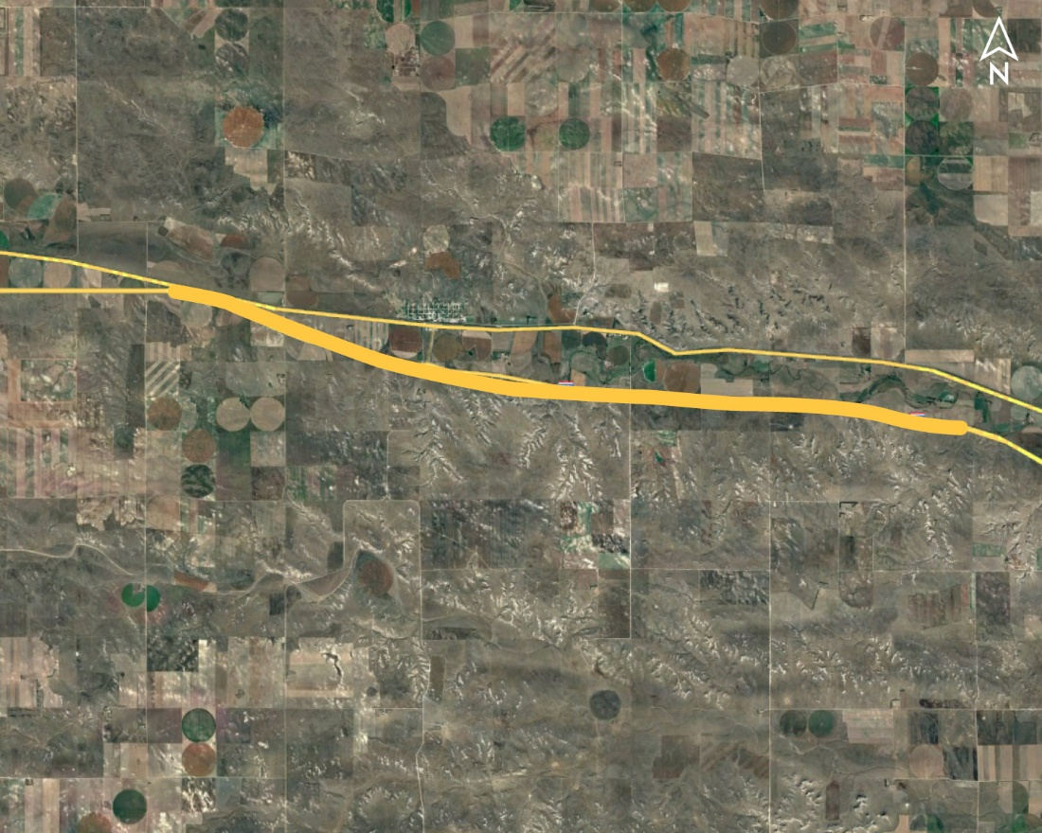
Potter - Brownson Project No.: NH-80-1(203); Control No.: 51628
Project Length: 11.6
Scope of Work:
Pavement Repairs

Slide 112
Potter - Brownson Project No.: NH-80-1(203); Control No.: 51628
Status: Design
Right-of-Way: Not Required
Traffic Impacts:
Phase Traffic Control
Letting Date: 8/29/2024
Construction Timing: 5/1/2025

Slide 113
Potter - Brownson Project No.: NH-80-1(203); Control No.: 51628
Anticipated Utilities Impact:
No Impacts
Anticipated Request from Utilities:
Provide Existing Locations
Coordination with NDOT
Additional Information:
No K-Sheets Required
No Special Provisions Required
Utilities Involved:
Charter Comm, Cogent (T-Mobile, Sprint),Dalton Telephone, Lumen (Century Link), OPTK (Nebraska Link), Warren Air Force Base

Slide 114
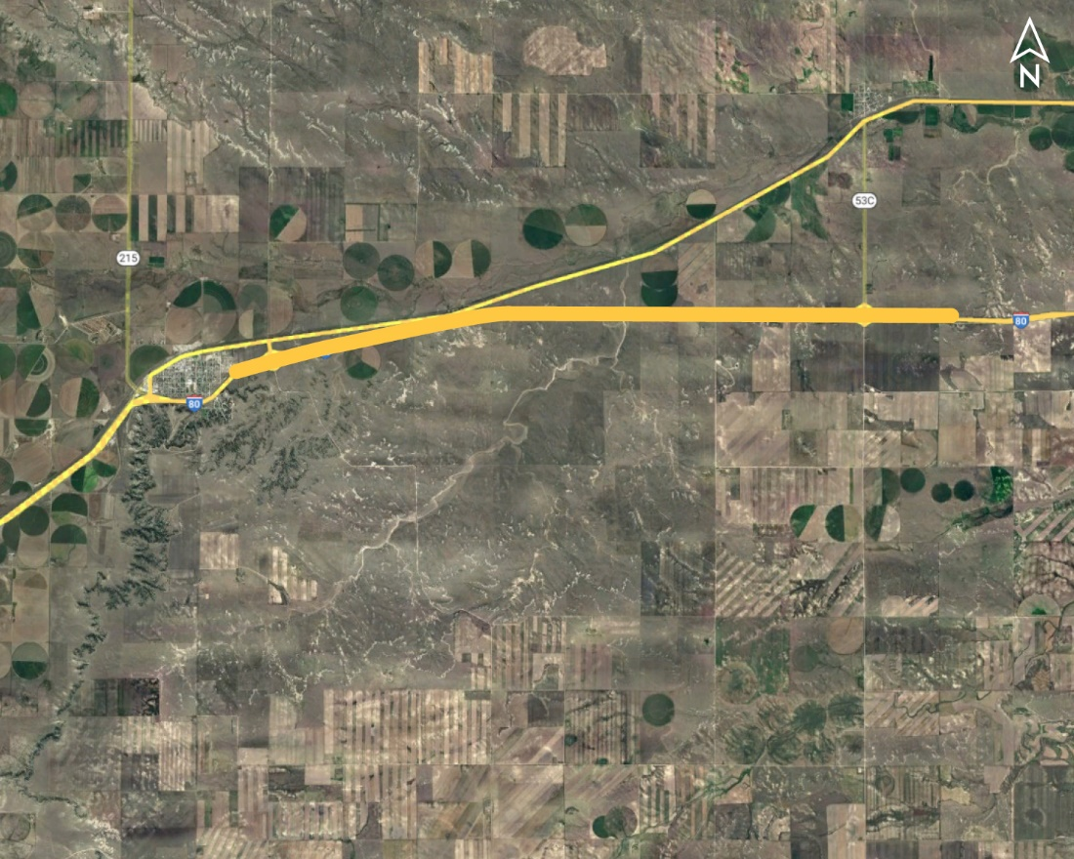
Wyoming Line - Bushnell Project No.: NH-80-1(204); Control No.: 51629
Project Length: 9.5
Scope of Work:
Pavement Repairs

Slide 115
Wyoming Line - Bushnell Project No.: NH-80-1(204); Control No.: 51629
Status: Design
Right-of-Way: Not Required
Traffic Impacts:
Phase Traffic Control
Letting Date: 8/29/2024
Construction Timing: 5/1/2025

Slide 116
Wyoming Line - Bushnell Project No.: NH-80-1(204); Control No.: 51629
Anticipated Utilities Impact:
No Impacts
Anticipated Request from Utilities:
Provide Existing Locations
Coordination with NDOT
Additional Information:
No K-Sheets Required
No Special Provisions Required
Utilities Involved:
Cogent (T-Mobile, Sprint), Dalton Telephone, Great Plains Comm, High West Energy, Warren Air Force Base

Slide 117
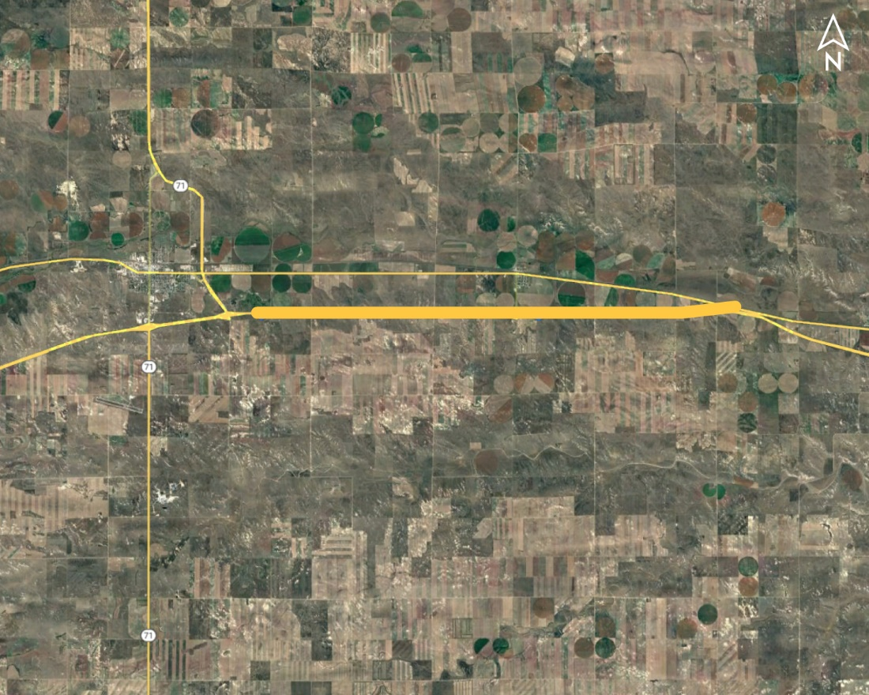
EAST KIMBALL - POTTER Project No.: NH-80-1(205); Control No.: 51630
Project Length: 11.7
Scope of Work:
Pavement Repairs

Slide 118
EAST KIMBALL - POTTER Project No.: NH-80-1(205); Control No.: 51630
Status: Design
Right-of-Way: Not Required
Traffic Impacts:
Phase Traffic Control
Letting Date: 8/29/2024
Construction Timing: 5/1/2025

Slide 119
EAST KIMBALL - POTTER Project No.: NH-80-1(205); Control No.: 51630
Anticipated Utilities Impact:
No Impacts
Anticipated Request from Utilities:
Provide Existing Locations
Coordination with NDOT
Additional Information:
No K-Sheets Required
No Special Provisions Required
Utilities Involved:
Chaco Energy, Cogent (t-Mobile, Sprint), Charter Comm, Dalton telephone, Foundation Energy Mng, Lumen (Century Link), Hig West Energy, OTPK (Nebraska Link)

Slide 120
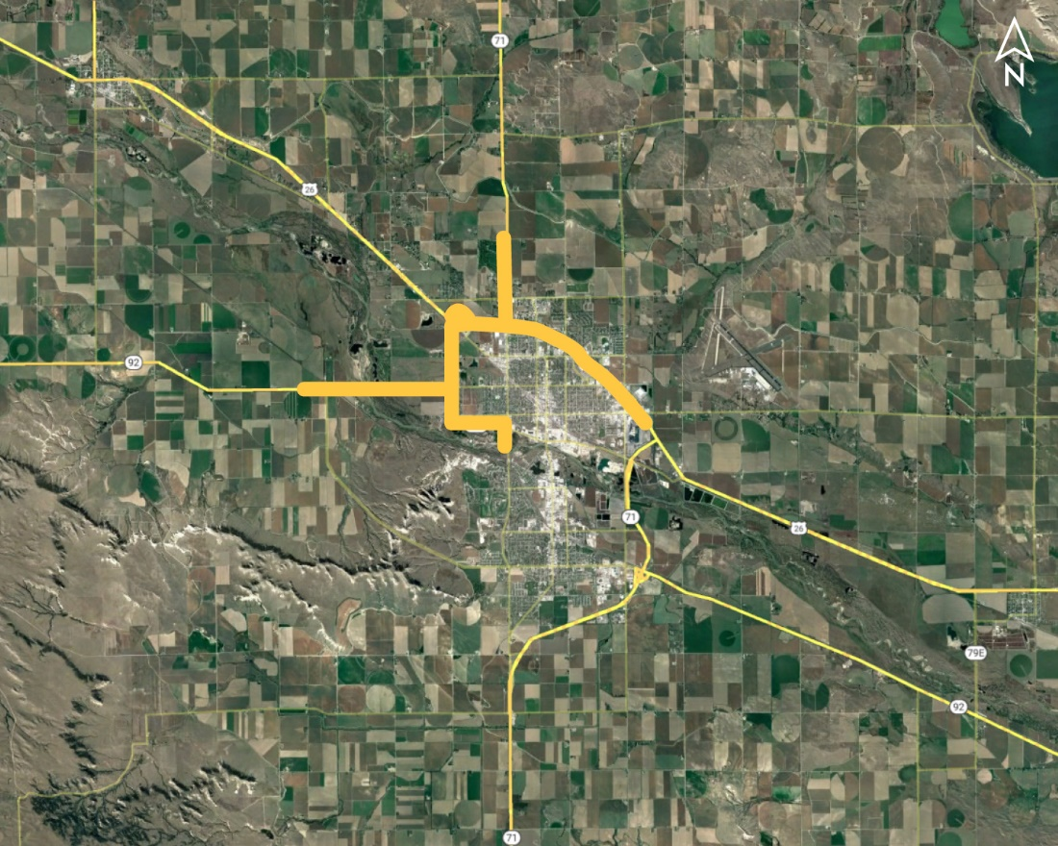
In Scottsbluff (MS) Project No.: NH-STP-26-1(178); Control No.: 51635
Project Length: 12.12
Scope of Work:
Resurfacing
Pavement Repairs
Bridge Repair

Slide 121
In Scottsbluff (MS) Project No.: NH-STP-26-1(178); Control No.: 51635
Status: Planning
Right-of-Way: In Progress
Traffic Impacts:
Phase Traffic Control
Letting Date: 12/12/2024
Construction Timing: 4/1/2025

Slide 122
In Scottsbluff (MS) Project No.: NH-STP-26-1(178); Control No.: 51635
Anticipated Utilities Impact:
Shlder Work
Grading
Anticipated Request from Utilities:
Provide Existing Locations
Coordination with NDOT
Additional Information:
No K-Sheets Required
No Special Provisions Required
Utilities Involved:
Action Comm, Black Hills Energy, City of Scottsbluff, Charter Comm, Enterprise Irrigation Dist, Lumen (Century Link), Nebraska PPD, OPTK (Nebraska Link), Roosevelt PPD, Western Sugar

Slide 123
Questions & Wrap Up
Notes:
HDR (Kristen, Amanda or Alyssa)

Slide 124
Any final Questions?
Ask them now!
If you have questions after this meeting, or would like to view more detailed project maps, please reach out to your utility coordinator.
Notes:
HDR (Kristen, Amanda or Alyssa)

Slide 125
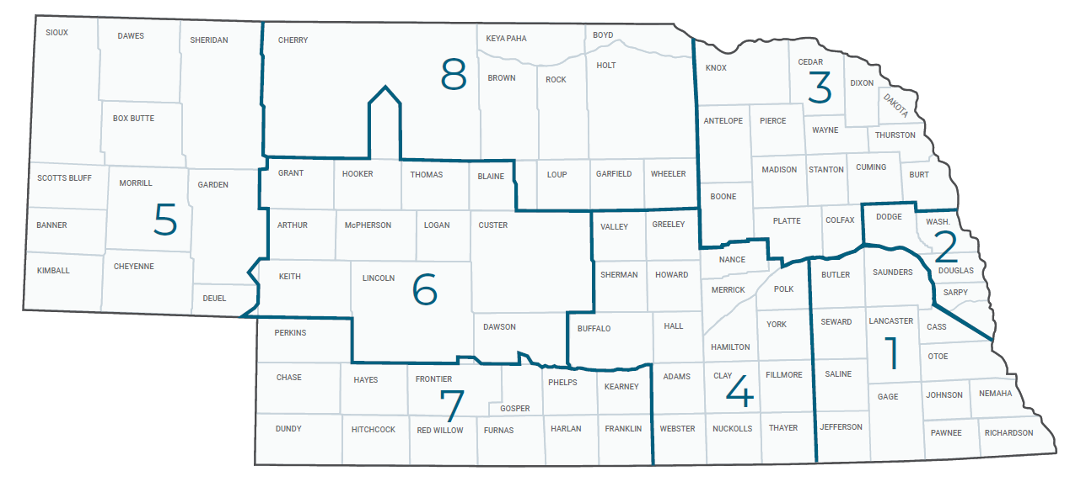
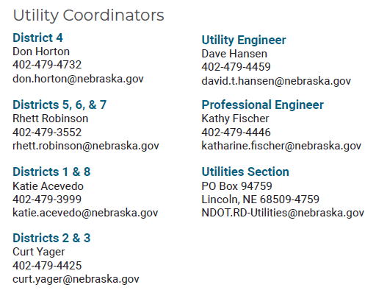
Have a Question about a project your Utility is involved in?
Contact your district’s utility coordinator!
Notes:
HDR (Kristen, Amanda or Alyssa)

Slide 126
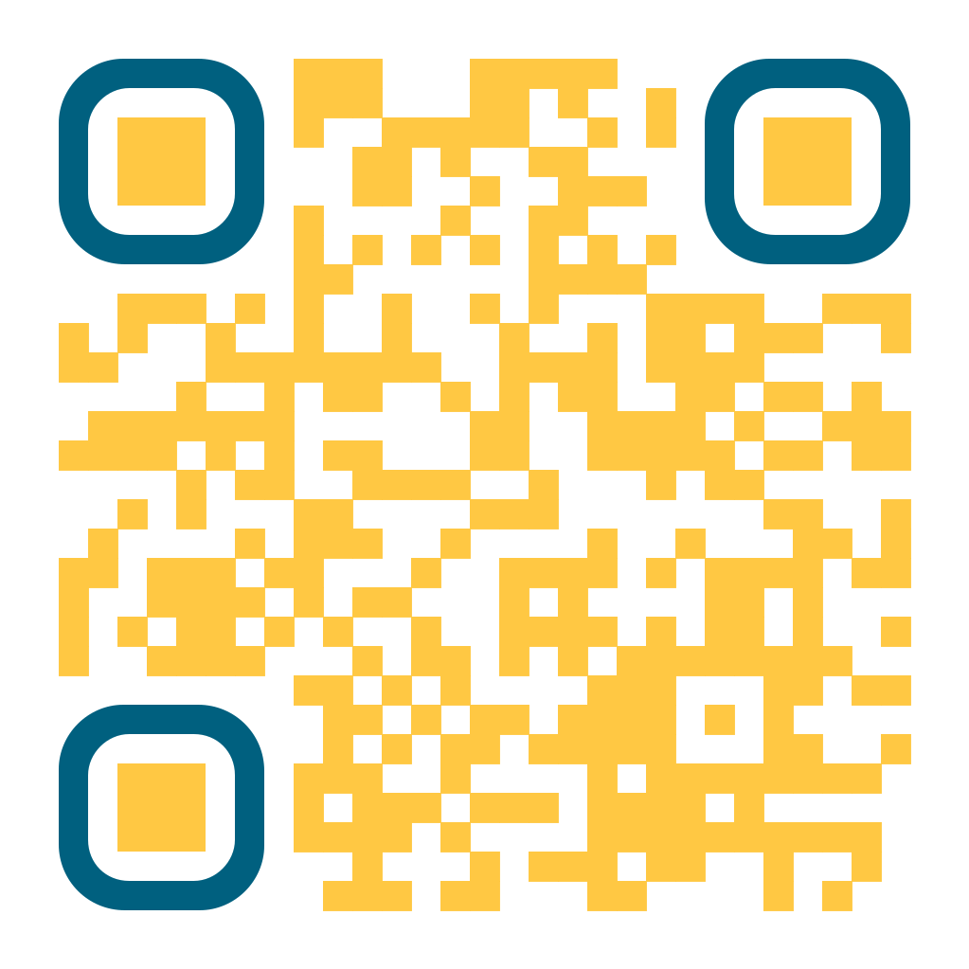
We need your feedback
Your valuable feedback helps these meetings – and NDOT’s utility coordination program – be better.
Use your phone’s camera to scan this QR code or use our paper survey.
Notes:
HDR (Kristen, Amanda or Alyssa)

Slide 127
Visit our Website
Visit NDOT.info/utility for more information on:
Utility accommodation
Permitting
Coordination
Project information
Reimbursements
Additional information
Notes:
HDR (Kristen, Amanda or Alyssa)

Slide 128
Thank You
Notes:
HDR (Kristen, Amanda or Alyssa)

