Slide 1
38th St Viaduct, Omaha
NH-275-7(205); C.N. 22806
Stakeholder Meeting
April 25, 2023
Notes:
Bill

Slide 2
Welcome
Thank you for joining us today!
Please sign-in at the welcome table if you haven’t already
Comment forms and a handout for the project are available
Staff are available following the presentation to discuss your questions and comments
Notes:
Bill

Slide 3
Agenda
Introductions
Project Overview
Impacts
Next Steps
Meeting Purpose: Seek input on viaduct options prior to designing viaduct improvements
Notes:
Bill

Slide 4
Introductions
Notes:
Bill

Slide 5
Project Overview
Notes:
Bill

Slide 6
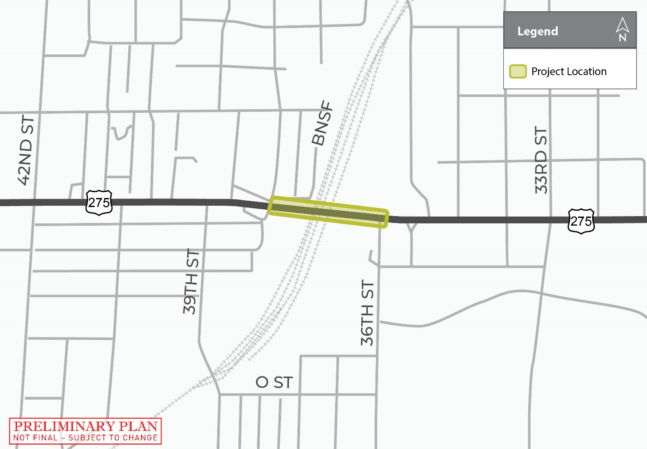
DESCRIPTION & Location
NDOT is proposing improvements to the 38th St viaduct on U.S. Highway 275 (US-275), known locally as L St, that crosses over the BNSF Railroad in Douglas County
Construction may begin and/or end approximately 1,500 feet ahead of or beyond both ends of the viaduct

Slide 7
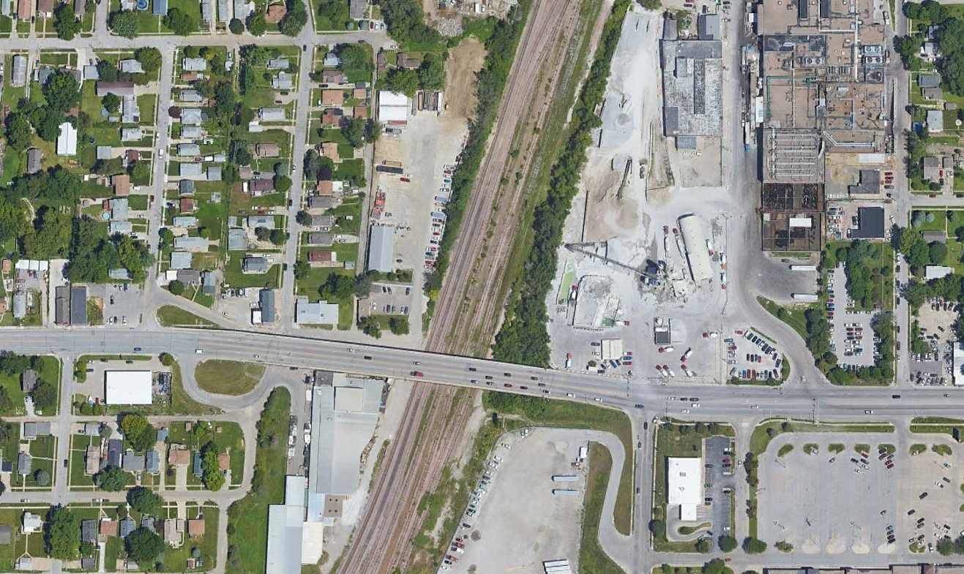
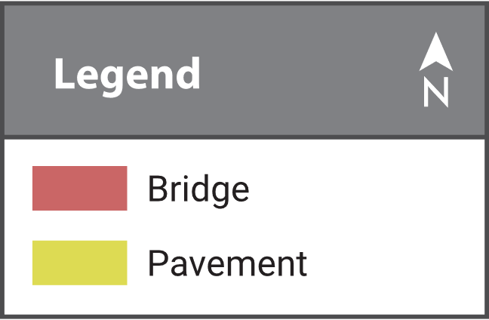
Aerial map
39th St
38th St
L St
39th St
38th St
36th St

Slide 8
Typical Cross section
Existing Viaduct
Improved and Widened Viaduct

Slide 9
Purpose & Need
The purpose of these improvements is to:
Preserve the transportation asset
Improve the reliability of the transportation system
Perpetuate the mobility of the traveling public
The need for this project is based on current condition of the bridge.

Slide 10
Scope of Work
The improvements would include:
Removing and replacing the existing viaduct
Americans with Disabilities Act (ADA) compliant curb ramps, sidewalks and bikeway work would also be included
Grading beyond the hinge point would be required for the entire length of this project
A grade raise of the entire structure is anticipated
The limits of pavement replacement would be determined by NDOT Roadway Design.
Notes:
Bill – storm sewer work

Slide 11
ALTERNATIVES

Slide 12
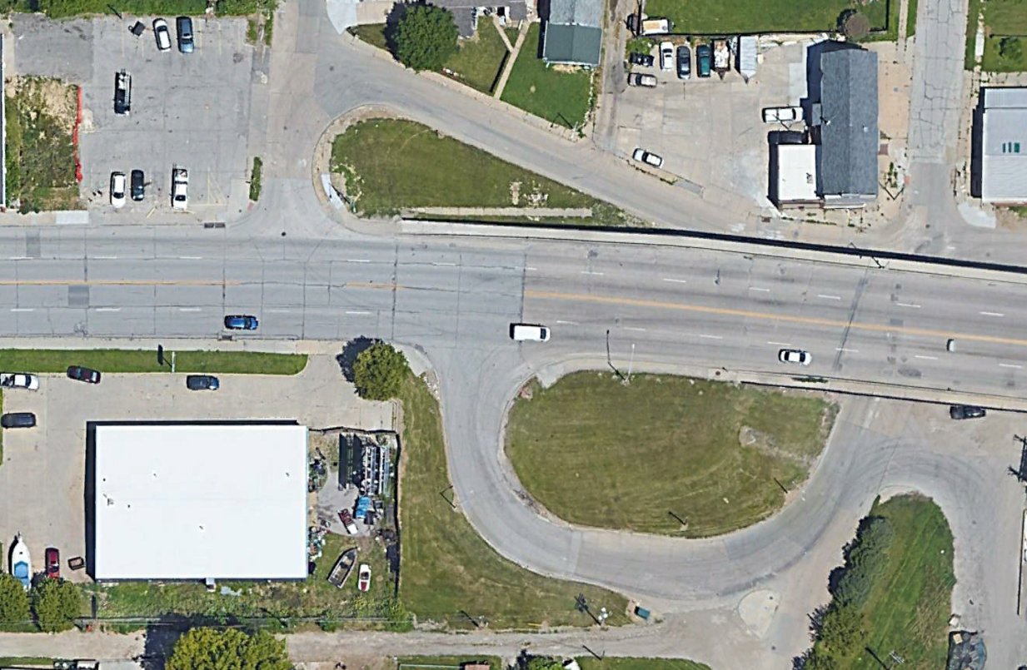
WEST END OPTION #1
Turn frontage road north of US-275 / L Street into a one-way street
No turn restrictions on US-275 / L Street
39th St
Frontage Road North of US-275 / L
38th St
L St
Frontage Road South of US-275 / L
Notes:
Bill - safety

Slide 13
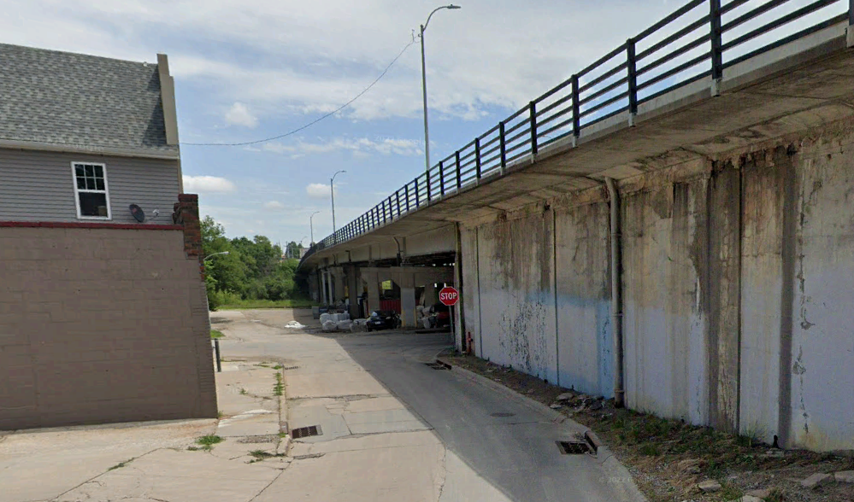
WEST END OPTION #1
VIEW EAST ON L ST FRONTAGE ROAD
PROPOSED RETAINING
WALL LOCATION
CANTILEVERED SIDEWALK
NOT A SIDEWALK
SIDEWALK TO REMAIN
Notes:
Bill - safety

Slide 14
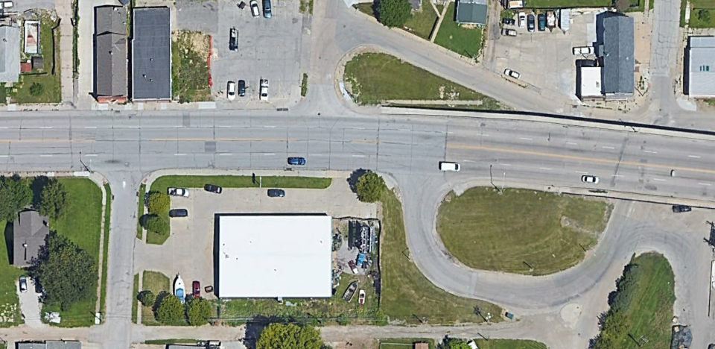
WEST END OPTION #2
Frontage Road North of US-275 / L
38th St
Turn frontage road north of US-275 / L Street into driveway only
No turn restrictions on US-275 / L Street
L St
Frontage Road South of US-275 / L
39th St
Notes:
Bill - safety

Slide 15
RAISED MEDIAN OPTION
39th St
Frontage Road North of US-275 / L
Add a raised median on US-275 / L Street.
RAISED MEDIAN
38th St
L St
Frontage Road South of US-275 / L
39th St
Notes:
Bill – explain benefits of raised median (safety)

Slide 16
EAST END Access
Close access north of 36th Street
OR
Leave access north of 36th Street as-is
L St
36th St
Notes:
Bill - safety

Slide 17
Impacts

Slide 18
project impacts
The proposed improvements would require the acquisition of additional property rights, which could include:
New right-of-way (ROW), control of access (CA), permanent easements (PE), and/or temporary easements (TE)
If your property is impacted by this project, you would be contacted by a representative once the design footprint has been established
Access to adjacent properties would be maintained during construction but may be limited at times due to phasing requirements

Slide 19
Traffic impacts
The majority of the project would be constructed under traffic with lane closures controlled by appropriate traffic control devices and practices
Some of the project work may be required to be accomplished at night
Overnight closures of US-275 / L Street may be required to facilitate construction
Local traffic may be detoured onto local roads

Slide 20
Pedestrian Impacts
The preliminary phasing plan would maintain pedestrian traffic across the bridge during construction on the north and/or south sides of the viaduct
Continued coordination would be required due to unknown phasing and constructability issues
When an alternative is selected, pedestrian accommodations would be determined. Should a pedestrian detour be required, the detour would be clearly signed

Slide 21
Next Steps

Slide 22
Anticipated Schedule & Cost
All dates / activities are subject to change

Slide 23
Feedback
A Public Information
Meeting will be held
in 2024!
Please submit questions, comments, or feedback to:
Sierra Luhn NDOT Public Involvement
PO Box 94759
Lincoln, NE 68509-4759
402-479-3103
sierra.luhn@nebraska.gov
Tim Weander NDOT District 2 Engineer
4425 S 108th St, PO Box 45461
Omaha, NE 68145-0461
402-595-2534
tim.weander@nebraska.gov

